Slide 1
Working with Foundation Programs and Campaigns
Eric Schmelling, Director, Fund Development
March 8, 2014
Notes:
Thank you again, Trustee Stephanie.
Rotary is at the forefront of changes of taking place in the philanthropic world.
PolioPlus and the Foundation’s new grant model are, of course, two excellent examples of how Rotary is learning and implementing best-practices – often we lead the field.
More specific to fundraising, Rotary is doing truly cutting edge work. Allow me to share three quick examples:

Slide 2

India’s Corporate Social Responsibility
Companies
Charity
2%
Notes:
First, Penelope just mentioned the changes to India’s laws encouraging Corporate Social Responsibility. It mandates approximately 7,000 companies’ give 2% of their profits to charity.
Rotary, recognizing this new opportunity, asked Sanjay Parmar, a senior member the staff in Delhi to take on a new job in which he will work with Rotarians to cultivate and solicit contributions from these companies. Sanjay is with us this morning.
This change in India – Rotary’s 4th most generous country to The Rotary Foundation – has great promise for our fundraising efforts.

Slide 3








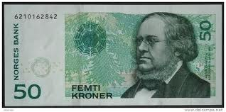

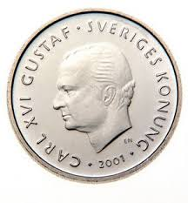



Rotary’s Online Giving Platform
AUD
ARS
DKK
EUR
JPY
CAD
GBP
NZD
NOK
USD
ZAR
BRL
CHF
SEK
Notes:
Second, Rotary’s online giving platform is a true reflection of Rotary’s commitment to innovation. Unlike any other organization, individuals are able to contribute online in 14 different currencies while preserving local tax benefits in most cases.
Work is currently underway to add currencies like the Korean Won and the Indian Rupee.

Slide 4

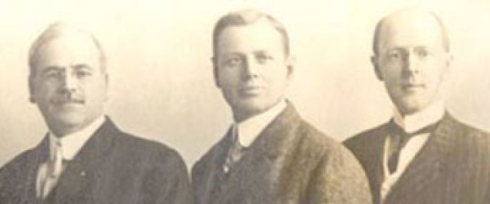






Associate Foundations
Rotary Foundation of the United Kingdom
The Rotary Foundation Canada
Rotary Deuthschland Gemeindienst E.V.
Deutsche Rotarische Stifung
The Australian Rotary Foundation Trust
Public Interest Incorporated Foundation, Rotary Foundation Japan
Notes:
Third, Rotary’s online giving platform builds upon and maximizes the benefits of the Foundation’s eight associate foundations.
I don’t know of another organization for which donors worldwide make contributions to common programs like Global Grants, PolioPlus, and the Peace Centers.
Of course, fundraising is more than just raising money for the sake of raising money; it is tied directly to the programs the contributions support. That is why we’re here today – it’s not about the money we raise but the good that it does.
What may be less apparent is that Rotary has been successfully running multiple fundraising campaigns for more than two decades. What do I mean?

Slide 5
Funds
Annual Fund
PolioPlus Fund
Endowment Fund
Rotary Peace Centers
Notes:
The Annual Fund – is a every member campaign
PolioPlus – the multiple campaigns have consisted of wide appeals
The Endowed Fund – has two aspects; a public face in that we ask every Rotarian to consider creating a lasting legacy by making a contribution. The private face is a more focused approach and engagement with Rotarians who can consider making a major gift of US$25,000 or more.
Rotary Peace Centers Major Gift Initiative – is a very targeted campaign. Over $100 M in gifts and commitments since 2005 from just over 3,300 donors. Most of this support is directed to the Endowed Fund and the majority came from the very largest contributions.
Sometimes people ask if our different funds and programs compete with each other. Let’s conduct a quick experiment to see how your own decisions and contributions might provide insights into this question.
Please raise your hand if you’ve ever contributed to the Annual Fund. Thank you.
Please raise your hand if you’ve ever contributed to the PolioPlus Fund. Thank you.
Please raise your hand if you’ve ever contributed to or made a commitment to the Endowed Fund. Thank you.
Finally, please raise your hand if you’ve ever contributed to or made a commitment to the Peace Centers.
You have just illustrated an important point – our supporters, our best supporters, are very likely to consider giving to multiple Foundation programs. In fact, giving to any fund makes it more likely the donor will support another.
In a few seconds you will hear more about the importance of taking a donor centric approach when working with major gifts. Fortunately, Rotary has several programs to which philanthropists can direct their resources. The continued development of Rotary’s areas of focus will add to the options and opportunities to attract more financial support in the future.
Let me conclude by summarizing that the field of philanthropy is rapidly changing and Rotary – in both our programs and fundraising initiatives – continues to be at the forefront.

