Slide 1
Trends Overview & Financial Update
2014 Coordinators & Advisers Institute
Chief Development Officer John Osterlund
Saturday 8 March

Slide 2
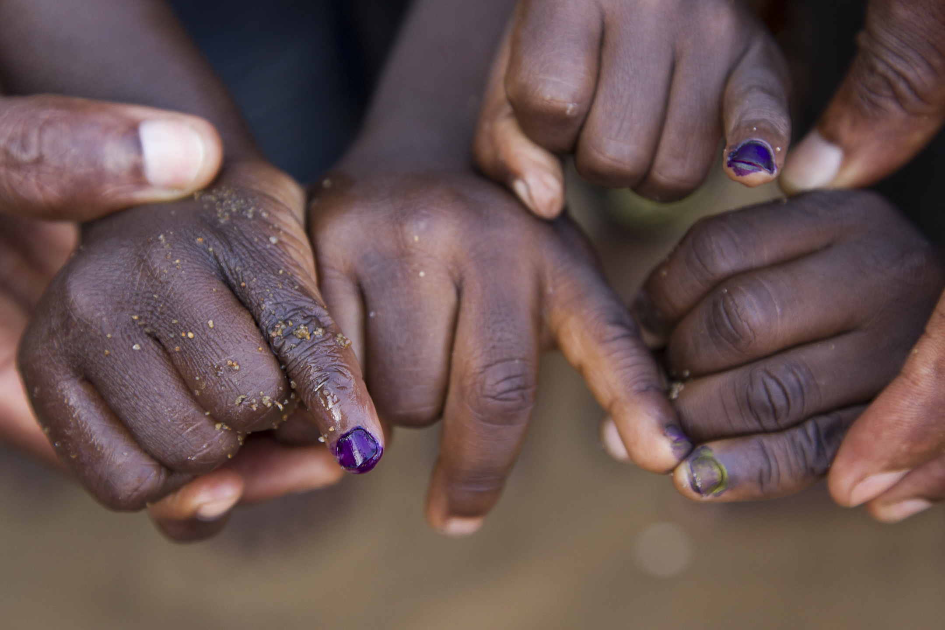
FOUR FUNDRAISING CAMPAIGNS
Annual Fund
2013-14 Goal: US$120 Million
Polio Eradication
US$35 Million over the next 5 years
Rotary Centers Major Gifts Initiative
US$125 Million by 2015
Rotary’s Endowment Fund
US$1 Billion by 2017

Slide 3

TREND ONE: ONLINE CONTRIBUTIONS (www.rotary.org/give)
Encourage more Rotarians to make contributions online
The fees associated with processing electronic contributions are substantially less than those associated with processing checks.
2012-13 by the numbers
US$8.1 Million in on-line contributions from 27,578 contributions
Only 7% of individual donors
Only 3% of total contributions

Slide 4

TREND TWO: ANNUAL FUND
Every Rotarian, Every Year
Supporting sustainable activities and transforming lives around the world.
Annual Fund by the numbers
2008-09: 22% of Rotarians contributed
2012-13: 29% of Rotarians contributed
2012-13: 80% of Rotary Clubs contributed
2012-13: 123 Districts at 100% participation

Slide 5

TREND THREE: ROTARY DIRECT
Rotary’s automated debit program
As with online contributions, fees associated with processing electronic contributions are substantially less than those associated with processing checks.
Rotary Direct by the numbers
2012-13: 7,355 Rotary Direct participants
2012-13: US$3.2 million
2012-13: Average contribution US$435

Slide 6

TREND FOUR: PAUL HARRIS SOCIETY
Supporting Rotary’s Annual Fund
The Paul Harris Society recognizes those who annually contribute more than US$1,000 or more to the Annual Fund, PolioPlus, or an approved Rotary Foundation grant.
The Paul Harris Society by the numbers
Currently less than 3% of Foundation supporters but more than 35% of Annual Fund contributions
Over 6,300 active members

Slide 7

TREND FIVE: BEQUEST SOCIETY
Growing Rotary’s Endowment
Creating an enduring legacy of good in the world
Bequest Society by the numbers
More than 9,674 Bequest Society members worldwide
626 joined in 2012-13
$47.5 Million in commitments
Average commitment: US$75,976

Slide 8
Contribution Performance First 7 Months of 2013-14
 | Actual $ Total | % Change As Compared to 31 January 2013
Annual Fund | $57.4 million | 5.8%
PolioPlus | $19.4 million | 27.5%
Endowment Fund | $18.5 million | 43.6%
Total | $107.9 million | 16.2%

Slide 9
Trends Overview & Financial Update
2014 Coordinators & Advisers Institute
Chief Development Officer John Osterlund
Saturday 8 March

