Slide 1
STRATEGY AND ENTERPRISE PROJECTS
Coordinators and Advisers Institute
Joe Brownlee
March 2014
Notes:
Greetings.
Introduction to our newly reconstituted team, Strategy & Enterprise Projects
We’ve brought together several like functions and activities around strategy, research, evaluation, data analytics, and project management to improve our services to Rotarians, staff, and others.
I will provide you a high-level update on the activities we are pursuing.

Slide 2
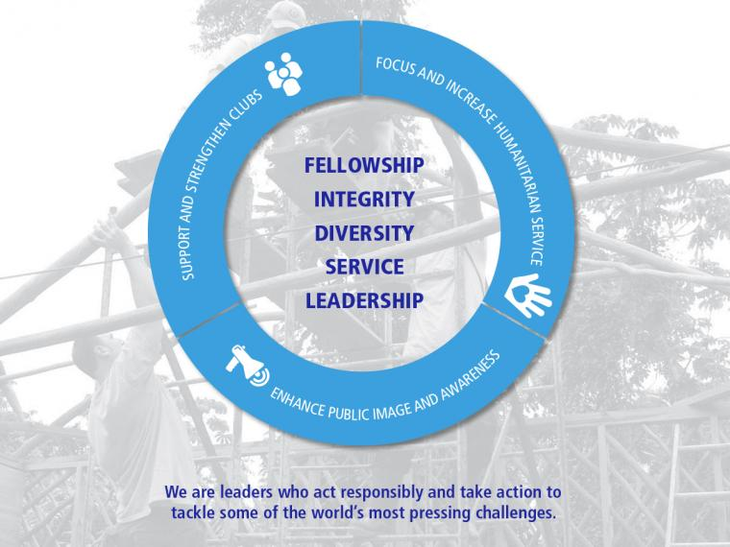
Notes:
First of all, we continue to implement the RI Strategic Plan.
This is a new depiction of our RI Strategic Plan using the new brand voice and identity. We’ve refreshed the look and feel of our promotional materials about the RI Strategic Plan, and we’ve provided a handout of the refreshed promotional flyer for your use.
You can find the updated version on rotary.org/strategicplan

Slide 3
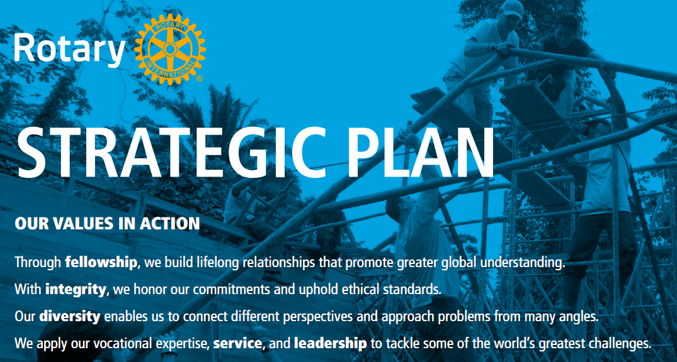
Notes:
We’ve also taken our values and put them into an active voice. Fellowship, integrity, diversity, service and leadership are all now presented in a proactive manner to better define what they mean.
We hope you like them.

Slide 4
STRATEGY & ENTERPRISE PROJECTS TEAM: PURPOSE/MISSION
To ensure that Rotary is a forward-looking organization and to help the Secretariat and its key stakeholders achieve their mission through measurement and evaluation, strategic alignment, and change management.
Notes:
As for our team, we are focused on this purpose or mission statement.
We want to look forward as an organization helping identify key trends in the market and different regions on what the needs and demands of our members and the general public are
We want to focus on measuring and evaluating everything we do to ensure we are making the right decisions based on the right set of facts and circumstances…that means research, market trends, and feedback from our key stakeholders—Rotarians and prospective members.
We also want to apply those decisions in a strategically mindful manner---try to remove as many emotions from the decision making process
And, finally, we know that all of this requires a significant focus on managing change as different people react to change differently.
We need to have a more structure approach in helping manage change throughout our organization

Slide 5
WHAT’S NEXT?
Longer-term, measurable strategic plan
Prioritizing enterprise projects and initiatives
Measuring Rotary’s global impact
Adoption of new tools and resources
Notes:
So, what exactly are we doing:
We are working closely with the board, trustees, and staff to further define our strategic plan in more measurable end-results based on the feedback received from surveys, focus groups, and other data collection points
We developed a more robust approach to how the Secretariat prioritizes it work efforts specific to big, organizational projects, in collaboration with the board, to deliver products and tools that are valuable to Rotarians and other stakeholders
We are working with tools like Rotary Club Central, Rotary Showcase, and other platforms to collect as much data from Rotary clubs to help them aggregate the total impact or value that they provide to their communities but also have a better understanding of the total impact in monetary value that district, zones, regions have on their communities, and ultimately Rotary has globally. We ask you all to promote these and other tools/resources to your fellow Rotarians and encourage them to use these tools to help tell Rotary’s story better
And finally, we are working closely with everyone to focus on adoption of these new tools. I mentioned managing change. Well we need to do a better job in helping Rotarians understand what is it for them by using these new tools and resources. We need your help.

Slide 6
CONTACT INFORMATION
Joe Brownlee, Chief Strategy & Enterprise Projects Officer
James Robinson, Director of Strategy, Research and Evaluation
Richard Plocinik, Director of Enterprise Projects
Contact us at spo@rotary.org

