Slide 1
STEWARDSHIP OF ROTARY FUNDS
Ravi Ravindran
President-nominee
9 March

Slide 2


Slide 3
FOUR WAY TEST
IS IT THE TRUTH?
IS IT FAIR TO ALL CONCERNED?
WILL IT BUILD GOOD WILL AND BETTER FRIENDSHIPS?
WILL IT BE BENEFICIAL TO ALL CONCERNED?

Slide 4
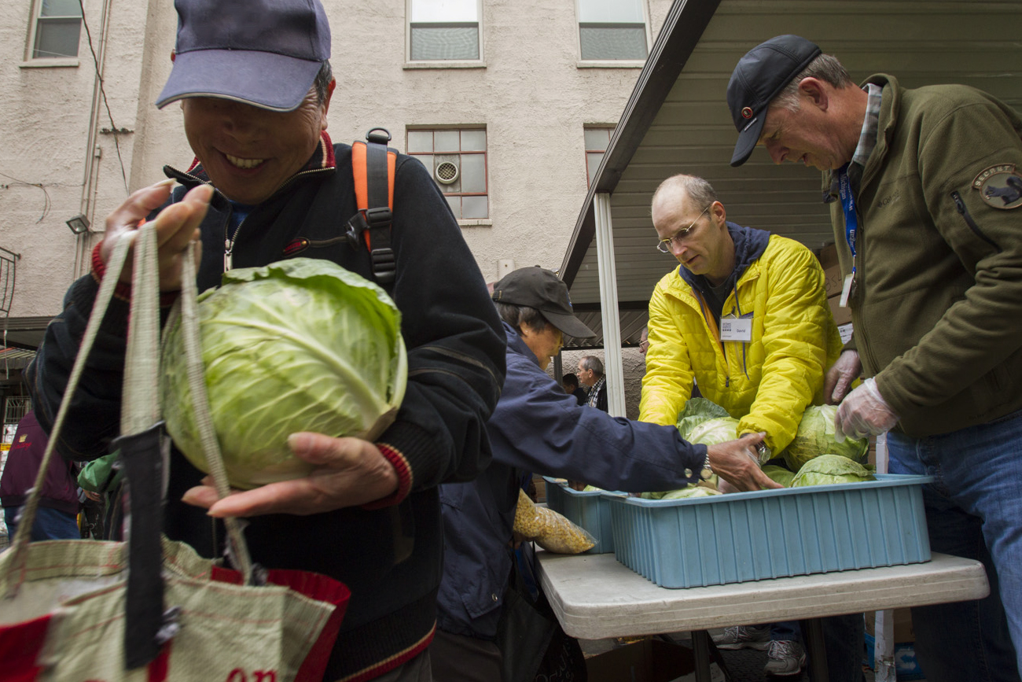
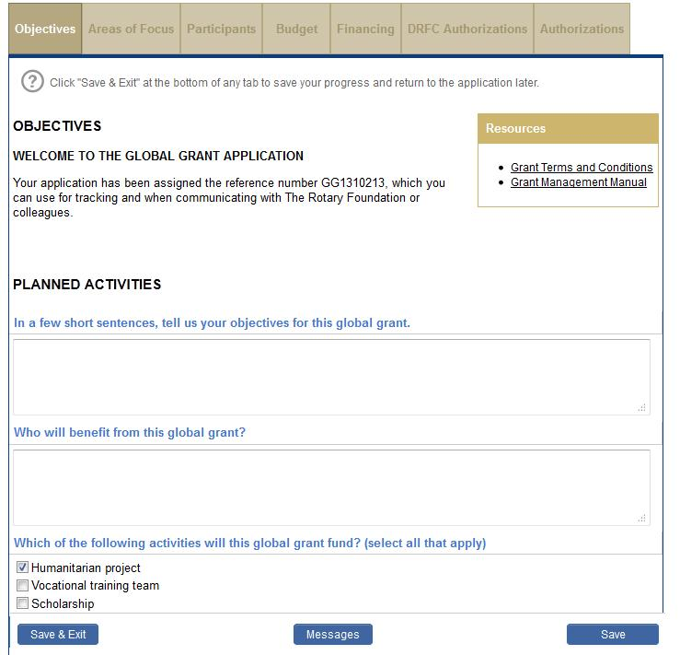

Slide 5
IMPROVEMENTS
Reporting
Violations

Slide 6
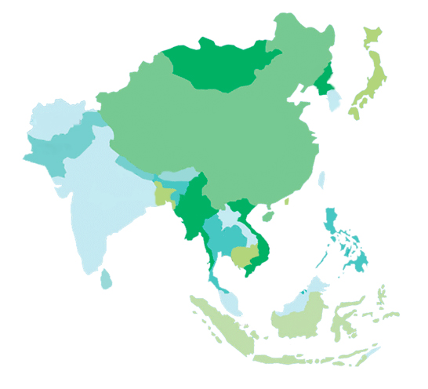
VISIT DISTRICTS

Slide 7
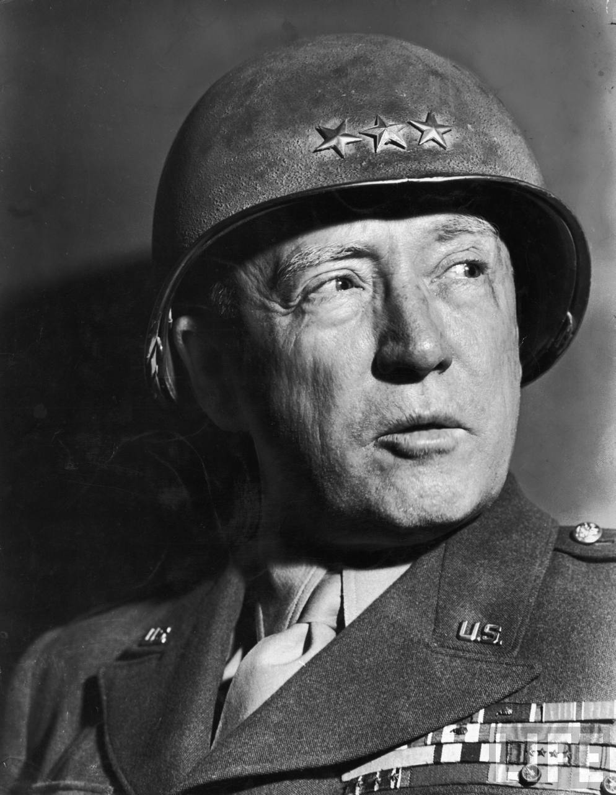
GENERAL GEORGE PATTON

Slide 8
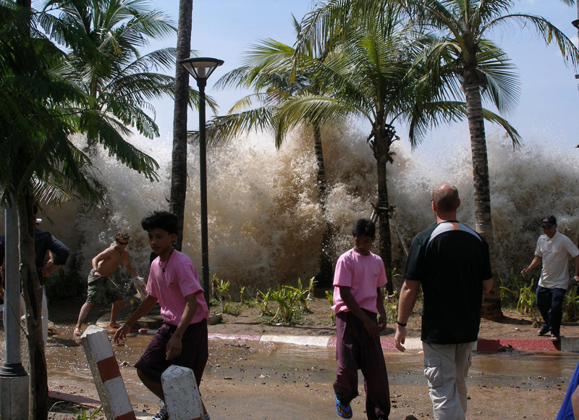

Slide 9






Slide 10
US$12-15m

Slide 11
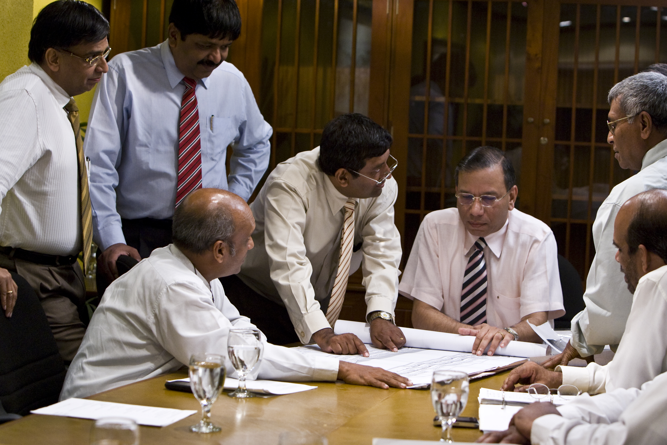
CENTRAL COMMITTEE

Slide 12
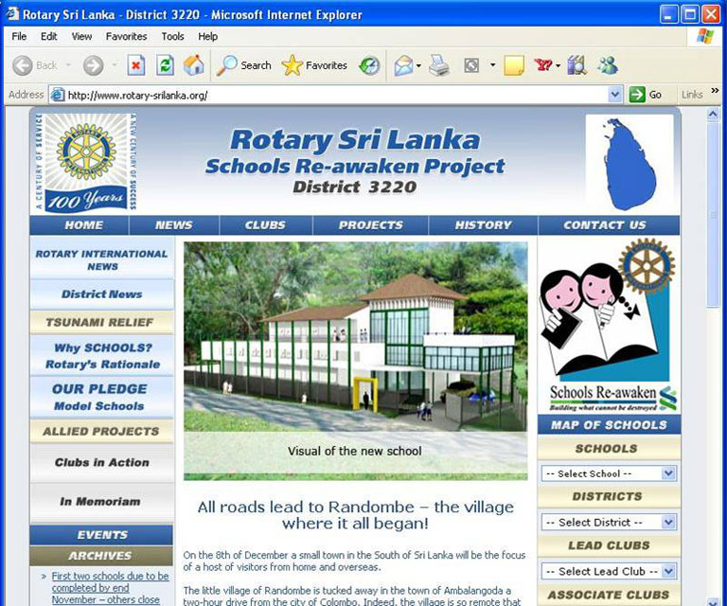

Slide 13
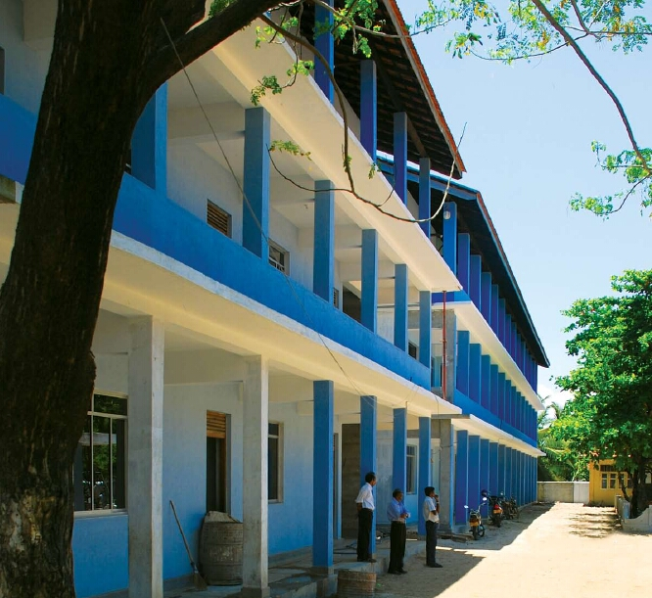
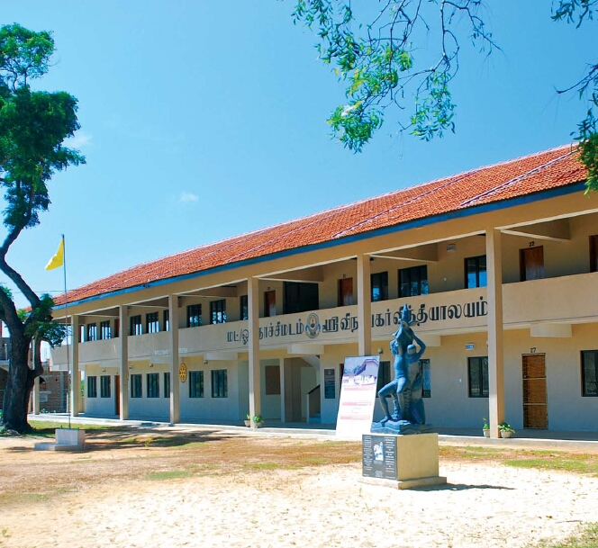
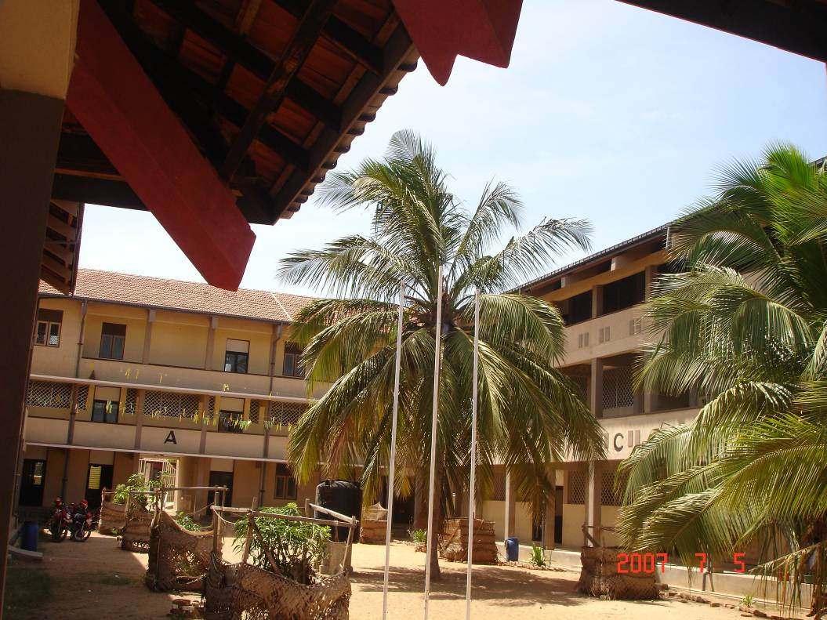
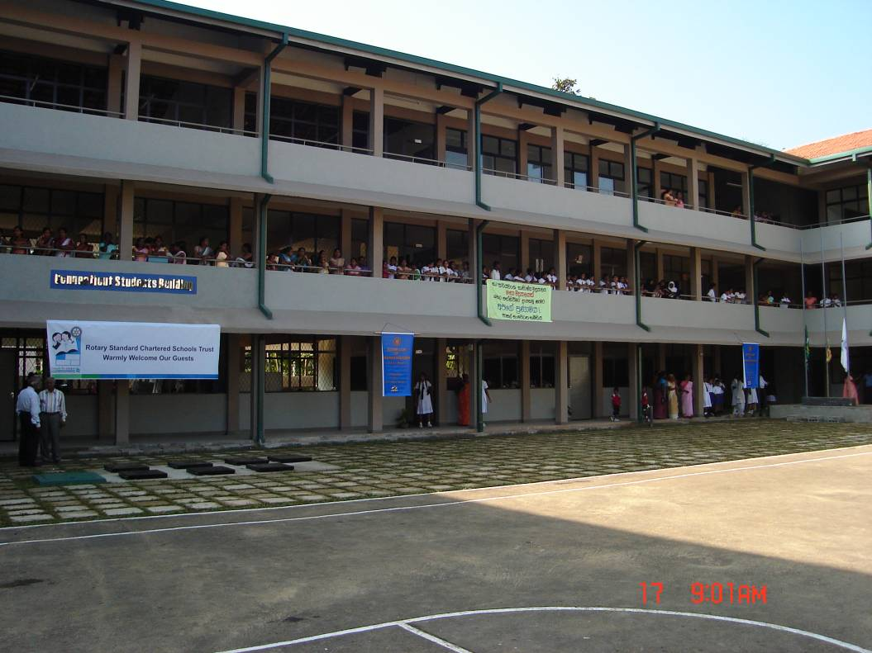
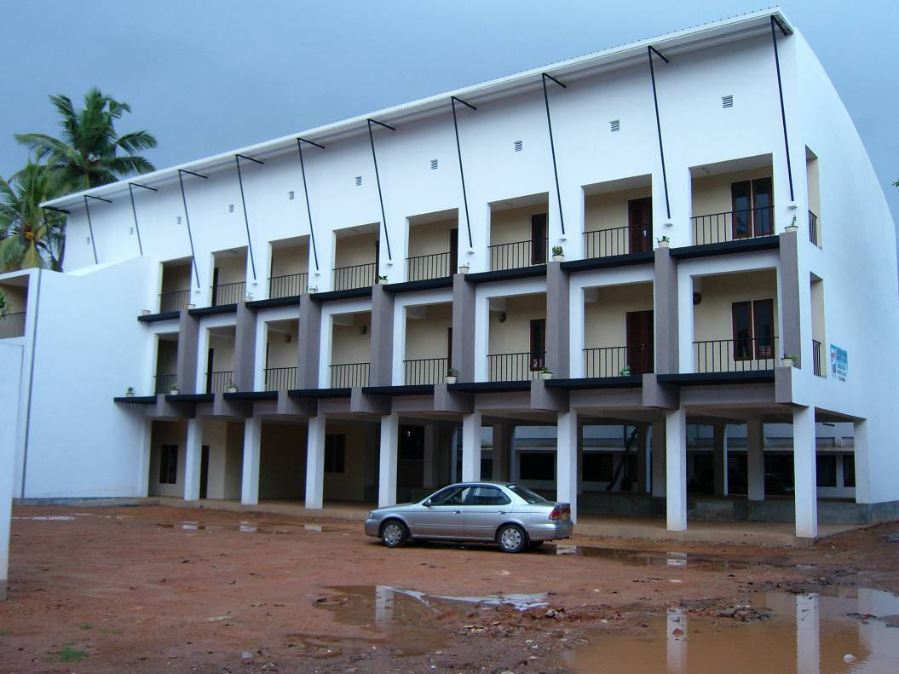
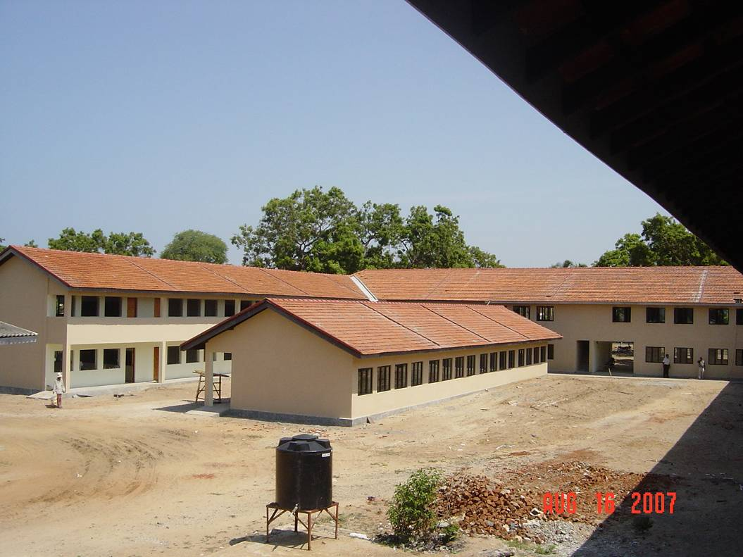
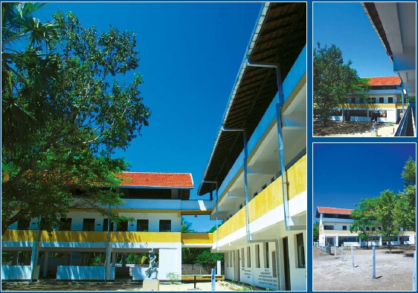
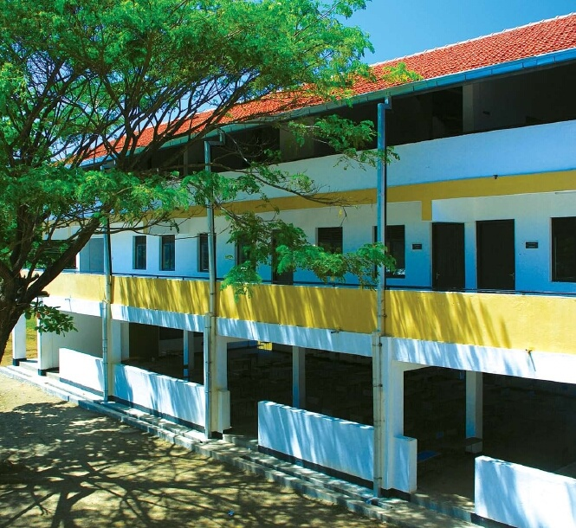
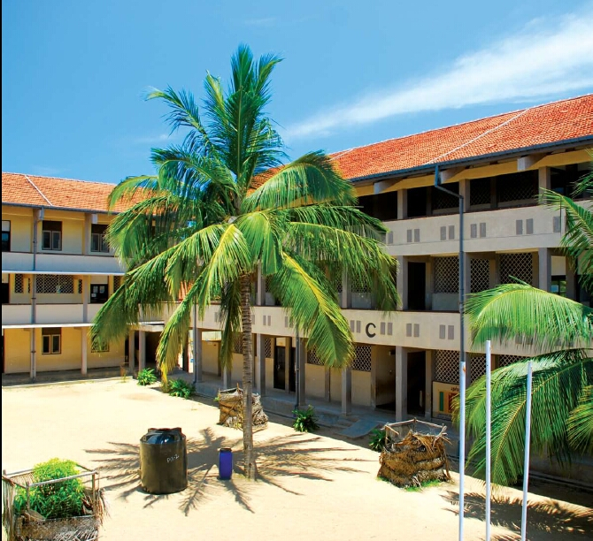
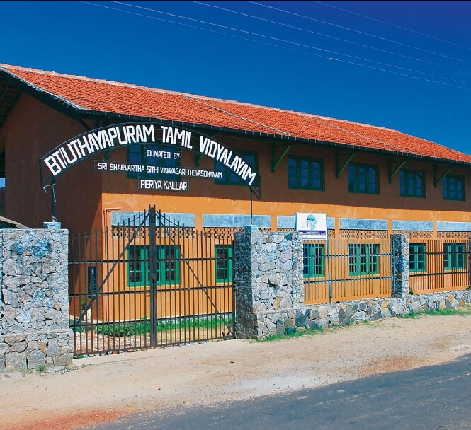
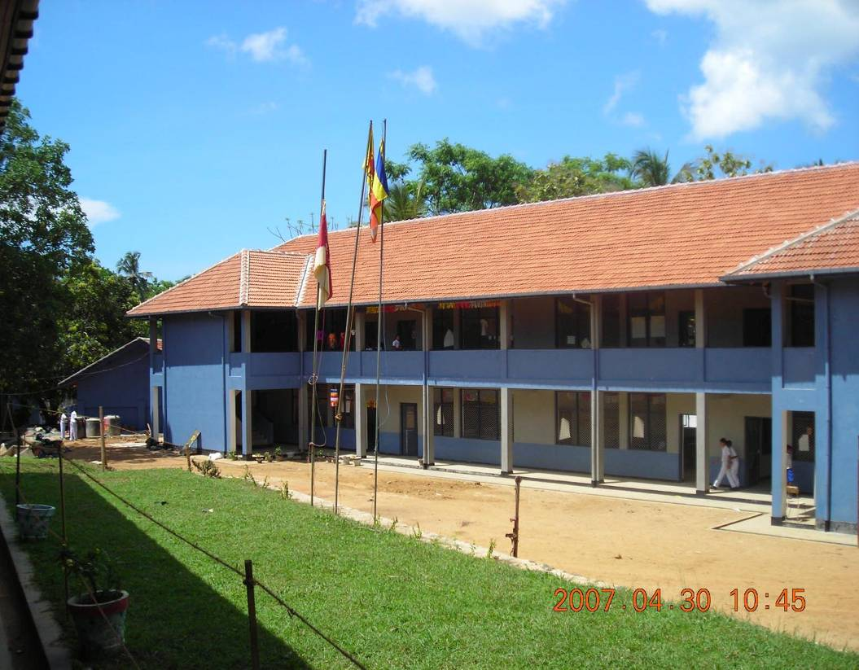
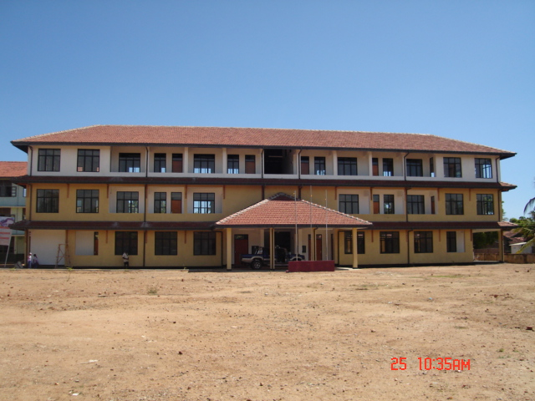

Slide 14


