Slide 1
USING ONLINE RESOURCES
Todd Lindley, RRFC Zone 31
March 7, 2014
Notes:
I’ve been asked to share with you about “Ways I’ve used online resources.” As RRFC, I use online reports for the 14 districts I work with on a regular basis. The primary reports I use are Club Recognition Summary, the EREY Eligibility Report and the Monthly Contribution Report.
We first use these during our Success Seminars at the beginning of the Rotary year to make sure that district leadership understand the powerful information contained in these reports.
I’m sure that you know where to find these reports, but with the change in our website, I’ll quickly review.

Slide 2
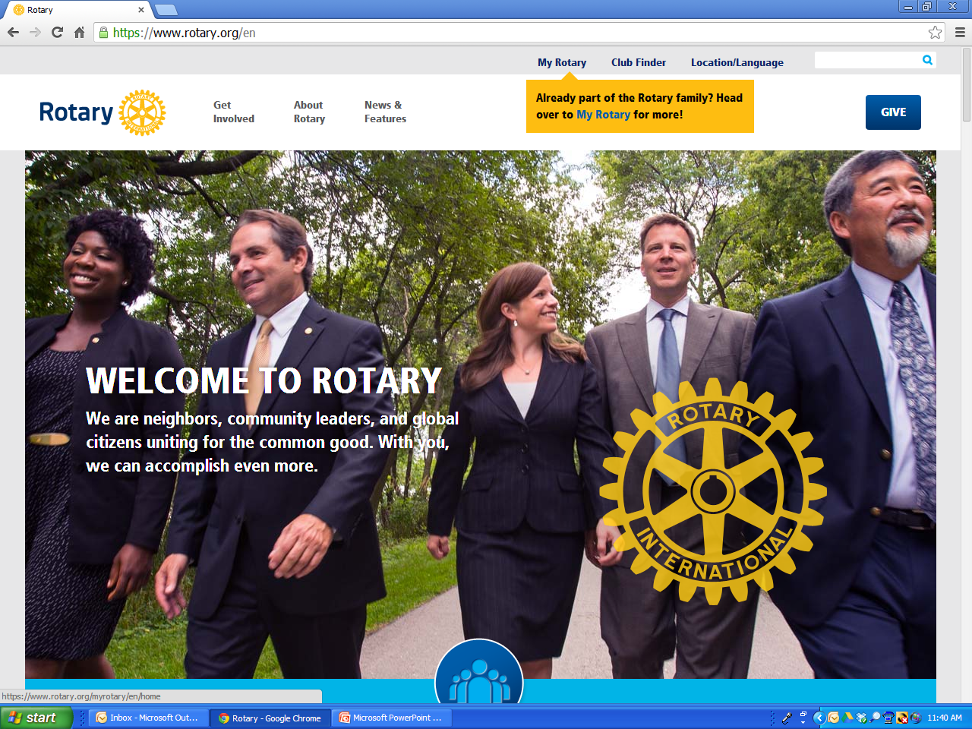

Section

Slide 3
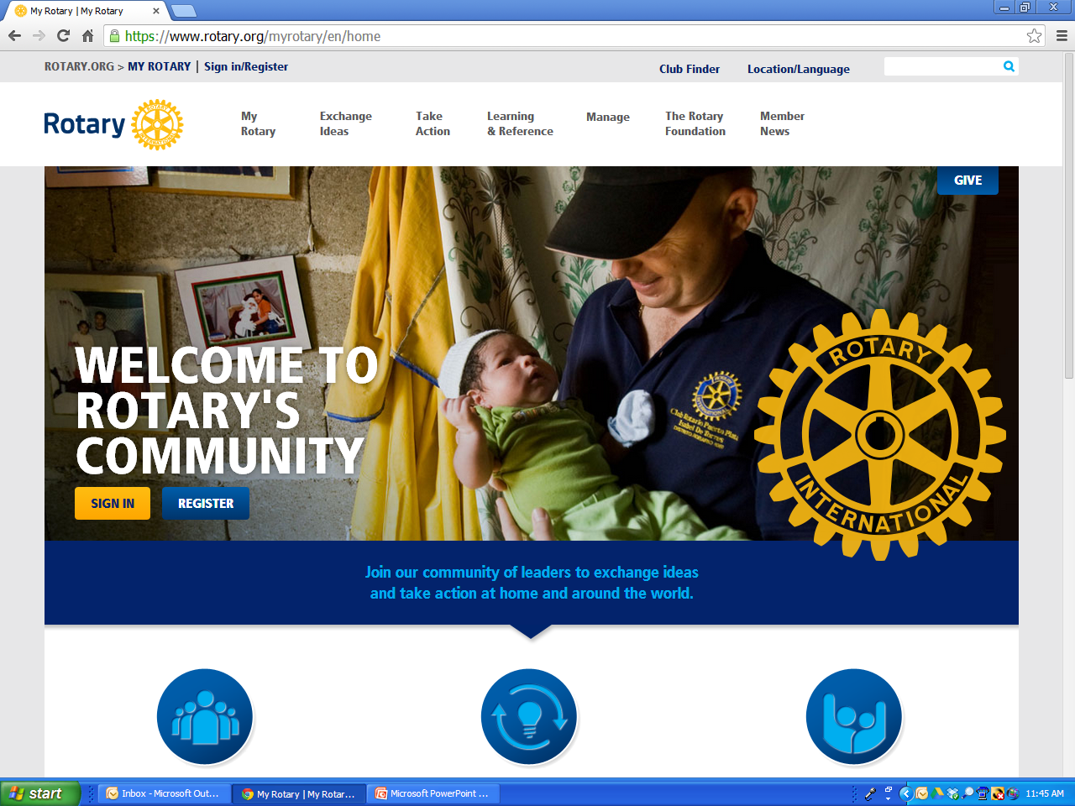
SLIDE TITLE
Head
Body
Subhead
Bullet

Slide 4
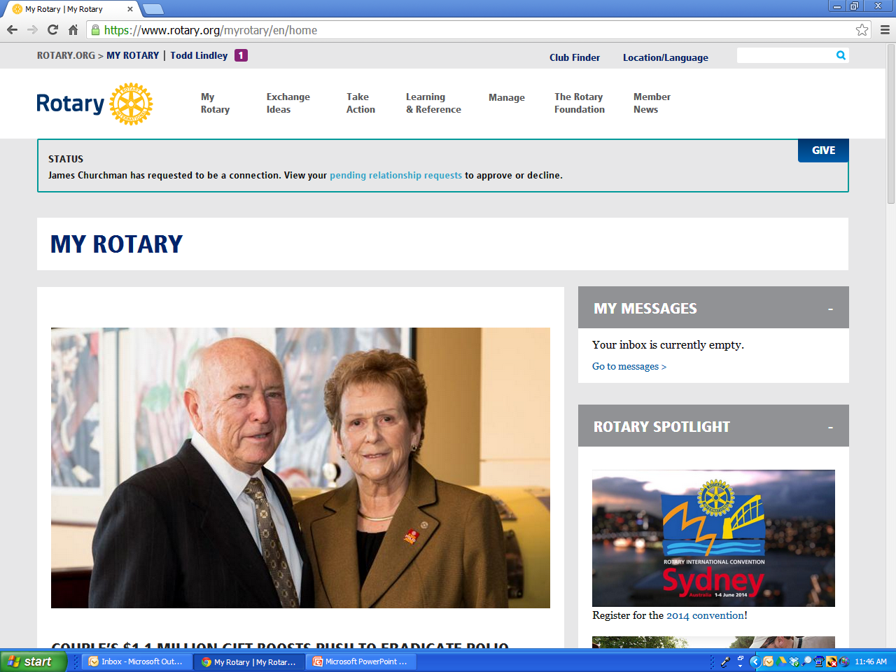
SLIDE TITLE
Head
Body
Subhead
Bullet

Slide 5
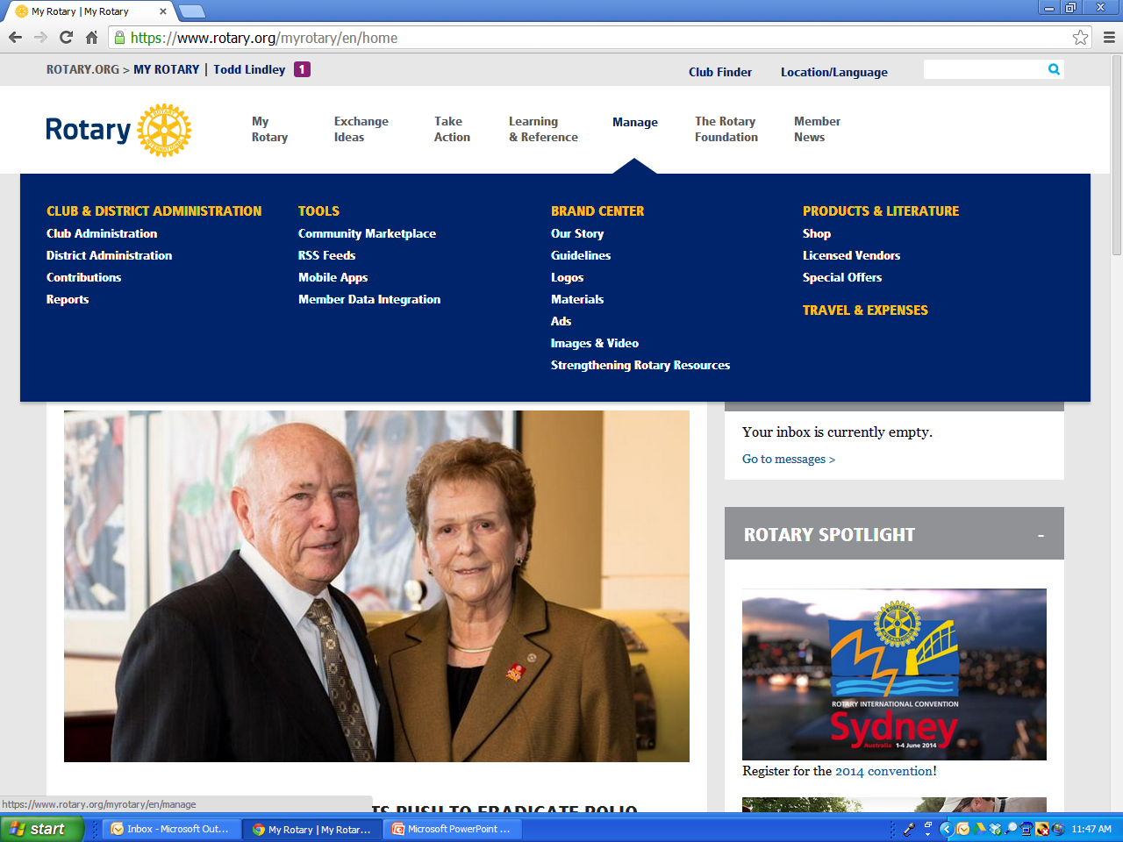
SLIDE TITLE
Head
Body
Subhead
Bullet

Slide 6
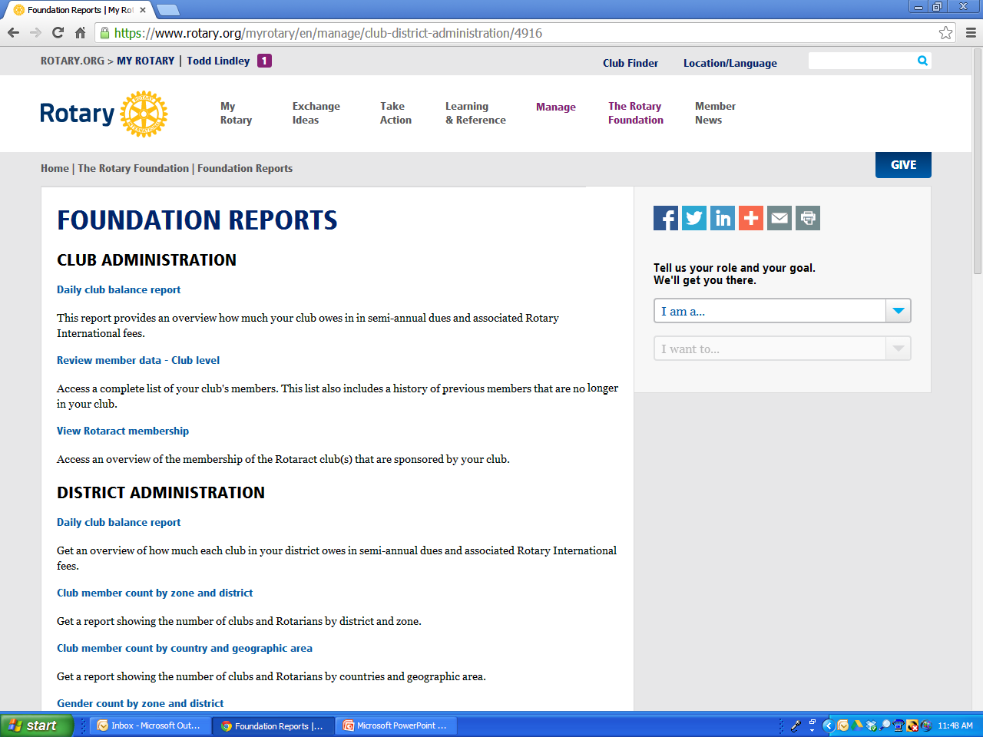
SLIDE TITLE
Head
Body
Subhead
Bullet
Scroll down

Slide 7
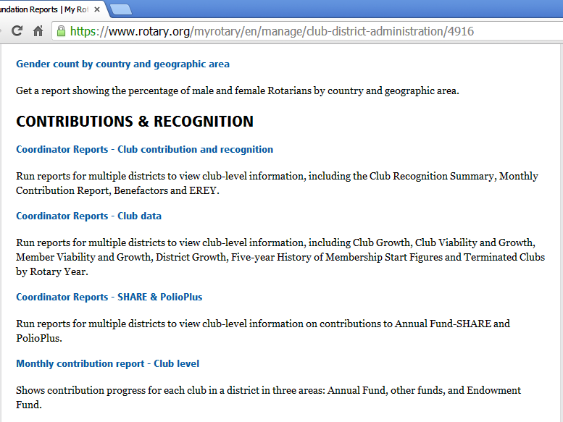
SLIDE TITLE
Head
Body
Subhead
Bullet

Slide 8
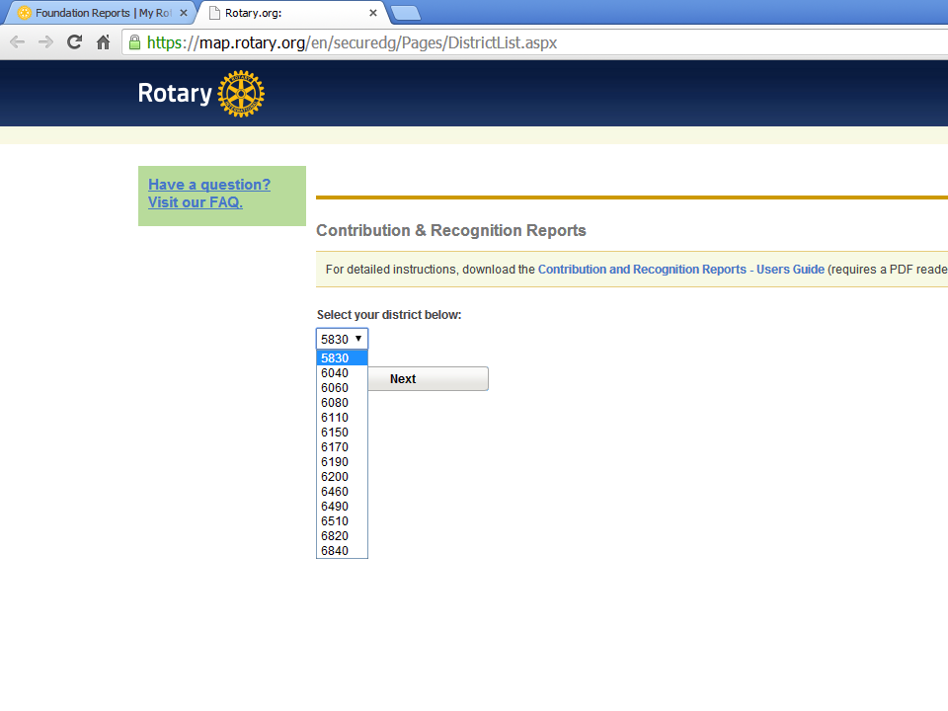
SLIDE TITLE
Head
Body
Subhead
Bullet

Slide 9
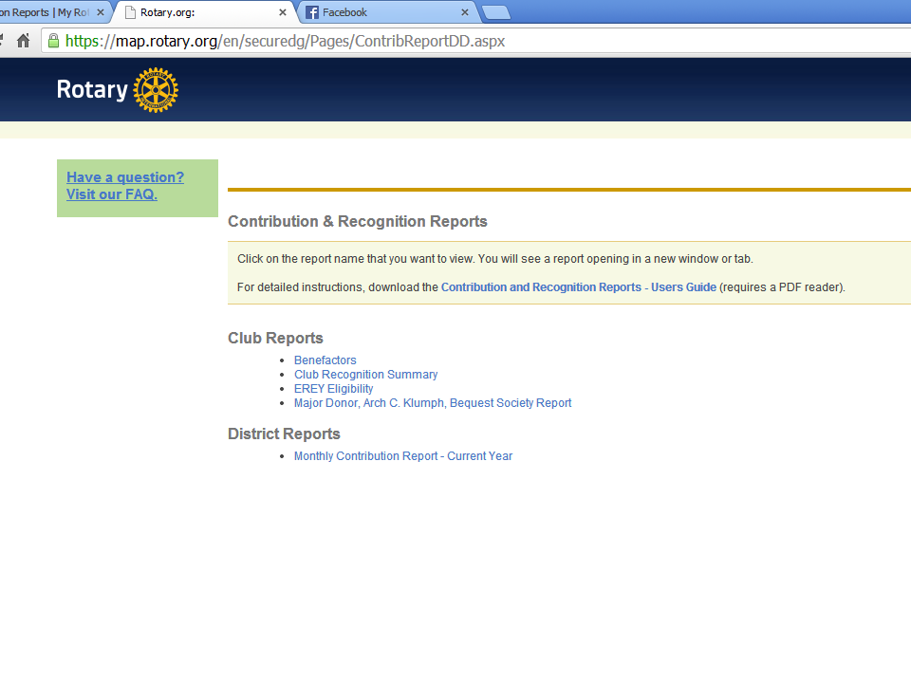
SLIDE TITLE
Head
Body
Subhead
Bullet

Slide 10
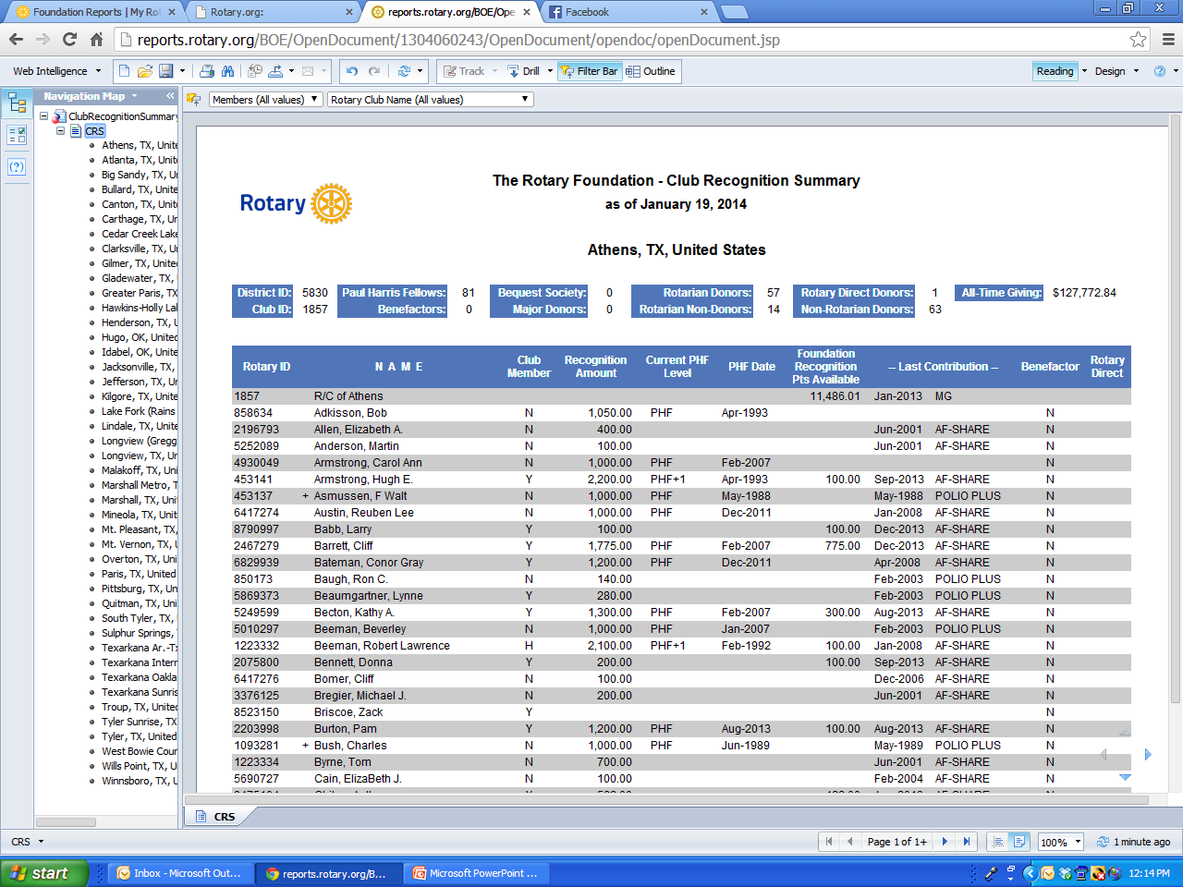
SLIDE TITLE
Head
Body
Subhead
Bullet
Notes:
The Club Recognition Summary is used primarily to help Rotarians reach their next Paul Harris Fellowship level. It is often most useful to filter for “Club Members” only.

Slide 11
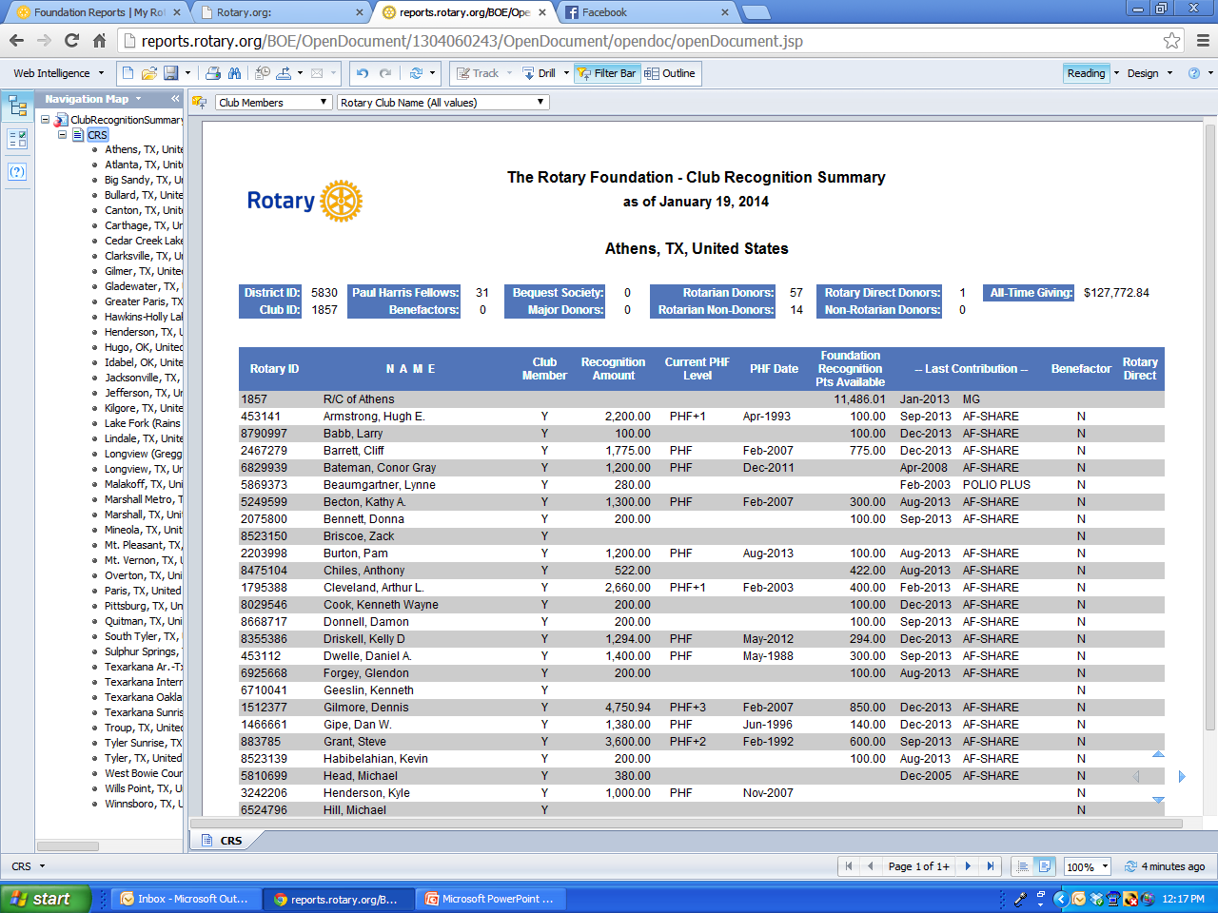
SLIDE TITLE
Head
Body
Subhead
Bullet
Notes:
This report can also be used to locate large collections of Rotary Foundation Recognition Points. The owners of these points can then be contacted about donating them for use in a Club or District Matching Gift program. One of my districts ran a Matching Donation program during March & April 2013, offering 1 Foundation Point for every dollar donated, with $100 minimum, but no upper limit. They had 40,000 points volunteered for use and they brought in $38,000 in Annual Fund donations. They found 55,000 more points to use this year and ran another matching program in November 2013, bringing in over $53,000 in Annual Fund donations. Teaching District Foundation Chairs and Annual Fund Chairs how to examine these reports and organize a Matching Gift program can have excellent results. Such campaigns require a bit of work, but can help bring in substantial Annual Fund donations, raising awareness of our Foundation and helping districts produce more DDF.

Slide 12
SLIDE TITLE
Head
Body
Subhead
Bullet
Notes:
The EREY report seems most useful later in the Rotary year, perhaps March through May. District leaders should be trained in using this report to help their clubs earn recognition banners. This raises awareness of our Foundation and results in increased Annual Fund giving. Rotarians feel good about being members of a club that is recognized for high performance. Helping clubs earn 100% EREY banners and 100% Sustaining Member banners is one part of that recognition.

Slide 13
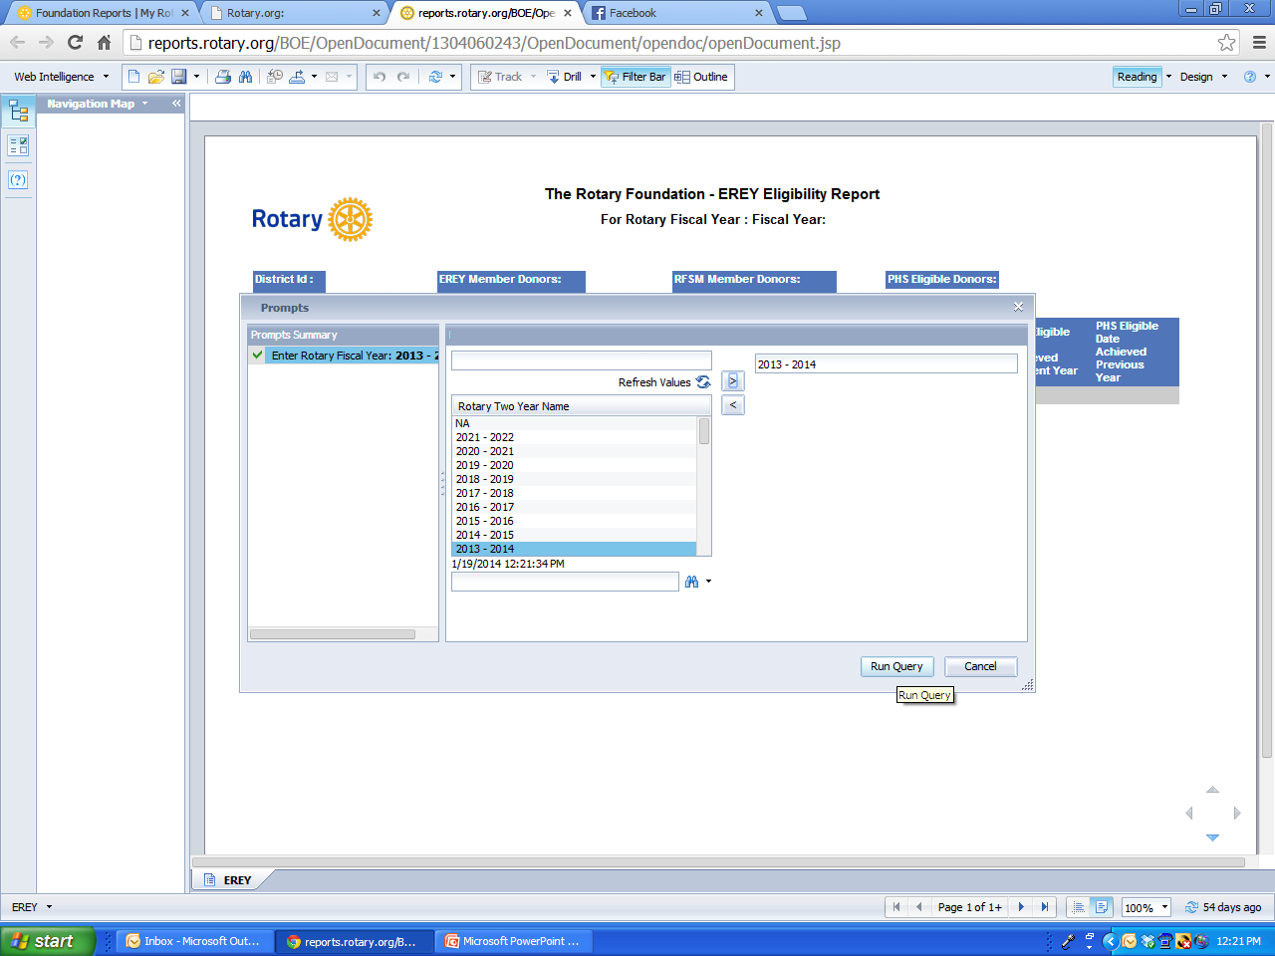
SLIDE TITLE
Head
Body
Subhead
Bullet

Slide 14
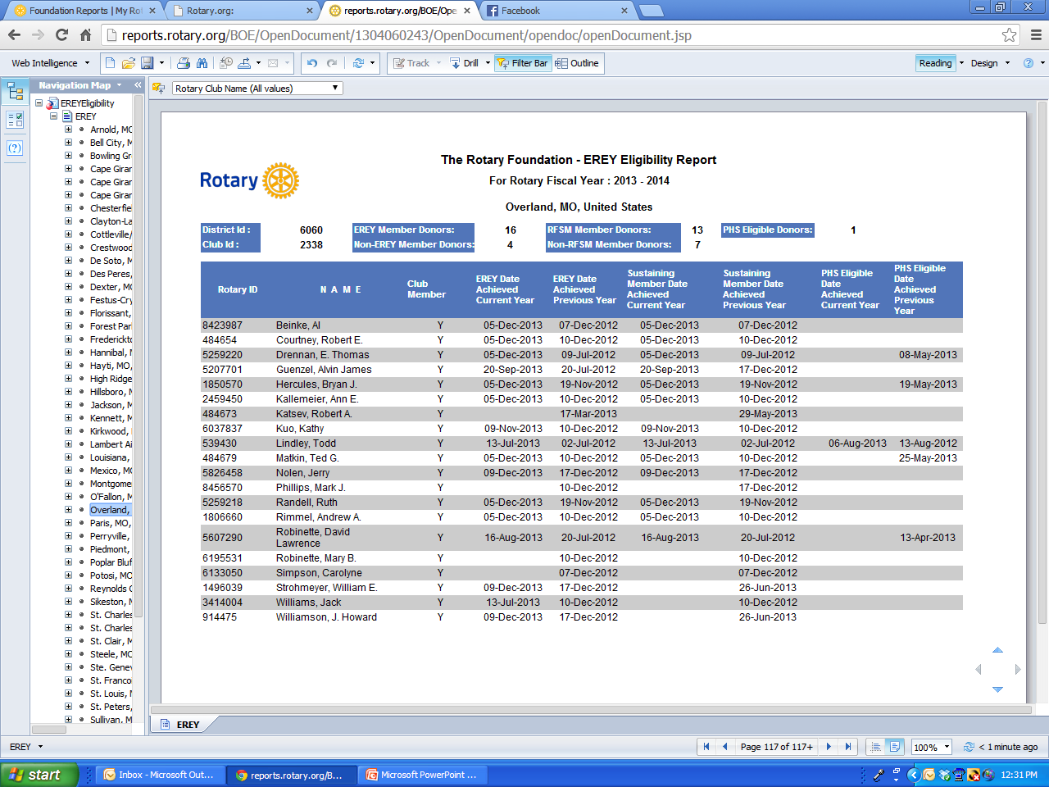
SLIDE TITLE
Head
Body
Subhead
Bullet

Slide 15
SLIDE TITLE
Head
Body
Subhead
Bullet
Notes:
I download the Monthly Contribution Reports for all my districts every 2-3 months. We can share them with the Governor and district Foundation team.

Slide 16
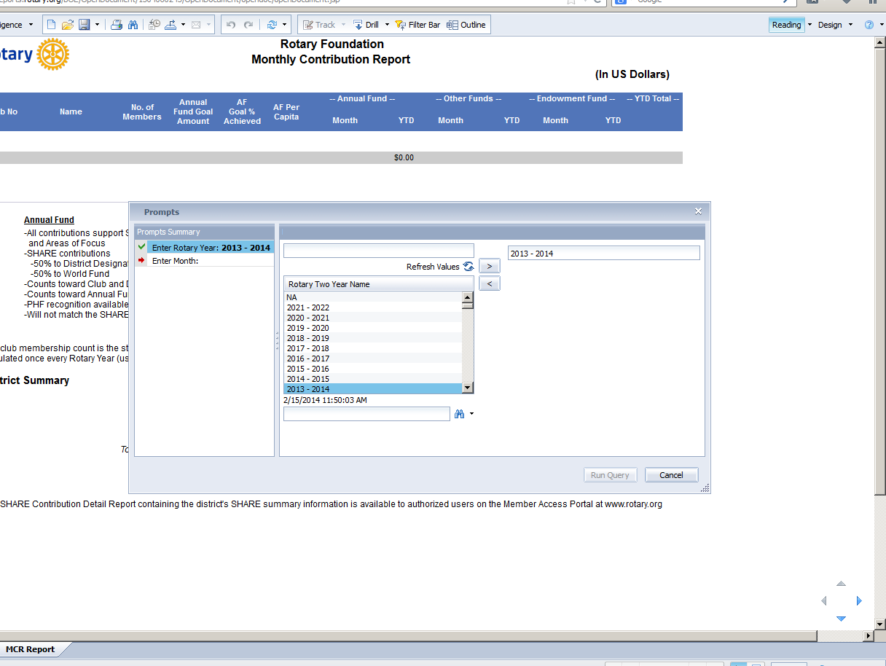
SLIDE TITLE
Head
Body
Subhead
Bullet

Slide 17
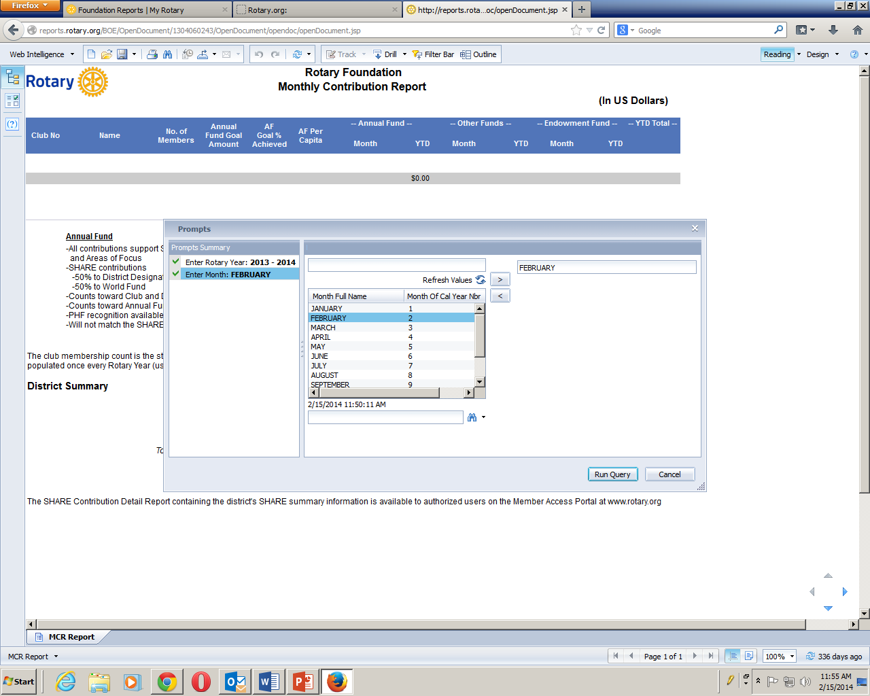

Slide 18
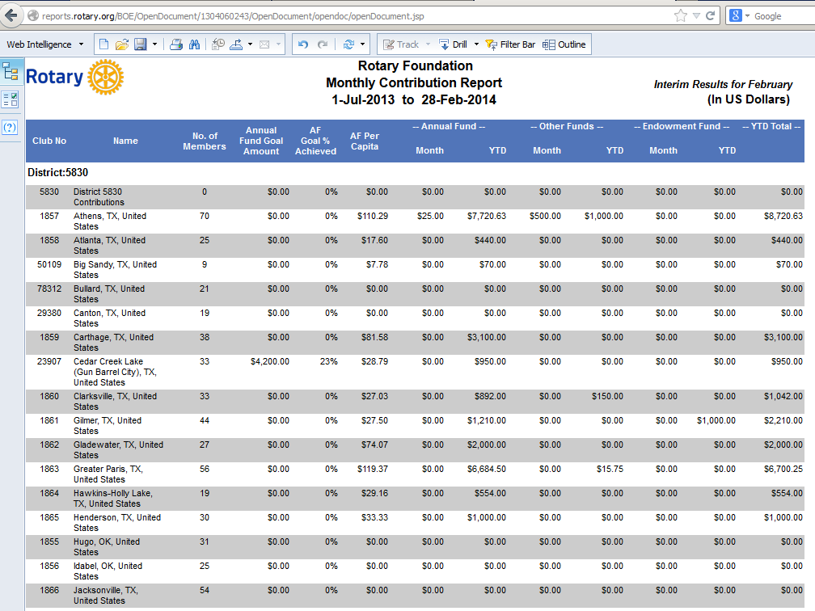
Notes:
It is possible to compare this year’s report to last year’s at the same month, to show clubs that are not performing as well as in previous years. Also the Monthly Contribution Report makes it easy to see clubs with zero giving and to see how clubs are doing relative to their posted goals.

Slide 19
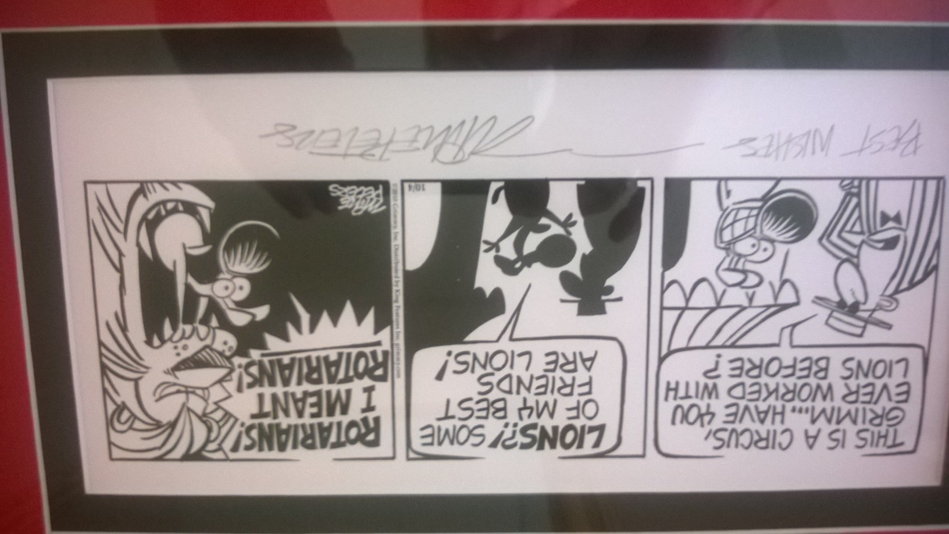
Notes:
Helping districts improve their Foundation giving is often a matter of finding clubs which are not supporting our Foundation and making sure their district can get some excellent Foundation programs in front of those club members. Rotarians are great people, interested in helping others. They are often not being well informed about what our Foundation is doing. These online resources can help us find those clubs and get communication and motivation sent their way.

