Slide 1
Global Fundraising
Penelope Cagney, MA, CFRE
March 8, 2014

Slide 2
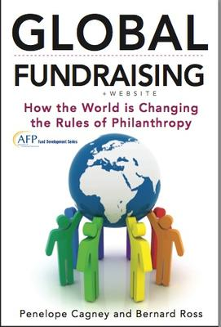
Penelope Cagney, MA, CFRE
President of The Cagney Company,
fundraising and management consultants
25 experience, three continents
Author:
“Nonprofit Consulting Essentials: What Every Nonprofit and Consultant Needs to Know” (Jossey-Bass/Alliance for Nonprofit Management 2010)
“Global Fundraising: How the World is Changing the Rules of Philanthropy” (AFP/Wiley 2013)
Association of of Fundraising Professionals (AFP)
Board of Directors
International Committee

Slide 3
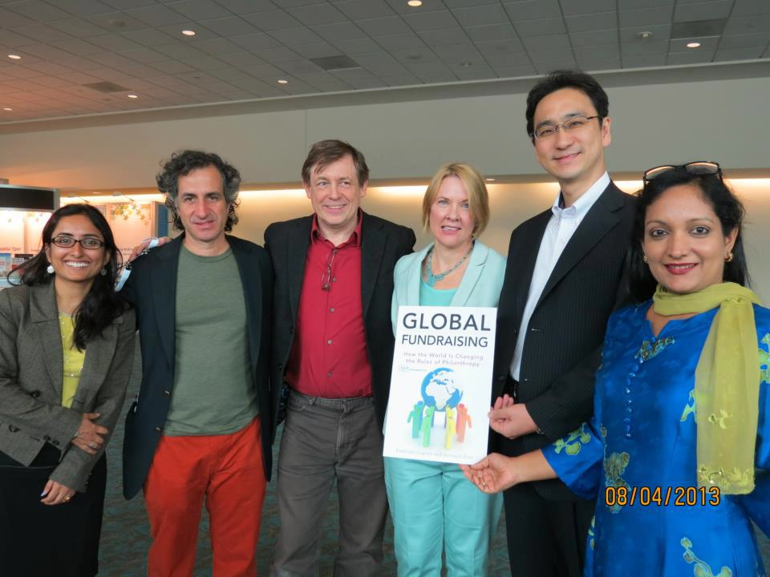
AFP International Conference 2013, San Diego, CA
Head
Body
Subhead
Bullet
Notes:
More than 20 experts from around the world contributed to “Global Fundraising”
-Here are some of the contributors at the book launch at the 2013 AFP Conference in San Diego (L-R): Sudeshna Mukherjee (New Delhi/New York City); Marcelo Iniarra (Argentina); Bernard Ross (UK); Penelope Cagney (USA); Masataka Uo (Japan); Usha Menon (Singapore)

Slide 4
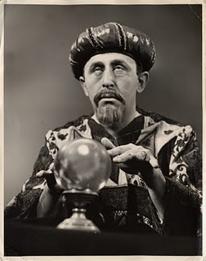
Notes:
Trends in philanthropy with implications for fundraising:
Sacred to the secular
Charity to philanthropy
North to South
Towards democracy and capitalism

Slide 5
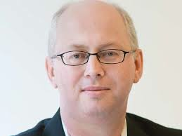
...“In the long term...philanthropy’s future will depend above all on the world’s progress in tackling the problems of humanity... by 2113, perhaps philanthropy will no longer be focused on basic needs—job done—but on the arts and the other higher things. That would indeed be something to celebrate. “
Matthew Bishop
New York bureau chief, The Economist, and co-author of “Philanthrocapitalism: How Giving Can Save the World” (A & C Black) From The World In 2013 print edition
Notes:
At the moment there is considerable optimism among some about philanthropy’s ability to resolve the world’s problems:
-Bill Gates says “by 2035, there will be almost no poor countries left in the world”
-Matt Bishop says by 2113 we will have addressed all basic needs
-John Maynard Keynes, the most influential economist of the twentieth century, looked to the day when society could focus on ends (happiness and well-being, for example) rather than means (economic growth and individual pursuit of profit)
Indeed there is good news:
-For the first time, in large portions of the world, the well-off actually outnumber the poor
-The educated outnumber the uneducated
-And those who see themselves as empowered make up a majority
And yet:
-Still great need for old-fashioned humanitarian aid
-...huge numbers of people in Asia and Africa continue to rise out of poverty, those who remain are increasingly in fragile states, exposed to war and crisis. In 2005, just 20% of the global poor were in conflict-affected and fragile states. Today that figure is 50 percent and set to rise to more than 80 percent in 2025.”*
-Troubling trend in individual countries towards the one percent vs. 99 percent
-Working for the Few concluded that 1 per cent of the world’s population controls half of its wealth. More remarkable still, the report estimates that the world’s richest 85 people own the same amount as the poorer half of the entire global population.
*Working for the Few looked at Credit Suisse’s Global Wealth Report 2013 and Forbes’ list of the world’s billionaires from 2013

Slide 6
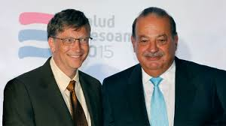
7 TRENDS
Great growth in wealth
?
?
Notes:
Just 5 percent those who signed the Giving Pledge are from outside of the US.* Philanthropists outside of US not necessarily following US pattern
More HNWI (high net worth individuals with assets of $1 million or more) individuals outside of the old world of North America, Europe and Japan today than in the past.
US still has the most (13.2 million) millionaires, followed by Japan (1.5 million) and China (1.3 million). Qatar, however, has the greatest density of wealth, with a mind-boggling 143 HNWIs out of every 1,000 households, followed by Switzerland (116), Kuwait (115), Hong Kong (94), and Singapore (82).*
The U.S. also had the largest number of billionaires in 2013 (492) followed by China and Russia.
Forbes found billionaires for the first time in Algeria, Lithuania, Tanzania and Uganda. Also for the first time, an African, Aliko Dangote of Nigeria breaks into top 25.*
More significantly, the ranks of the wealthy are swelling in the new world compared with the old: the former grew 12.9 percent and the latter grew only 5.9 percent in 2012.
*http://www.wealthx.com/articles/2013/why-only-5-of-the-world’s-billionaires-have-signed-the-giving-pledge/
*2013 World Fact Book
*Credit Suisse 2013
*Forbes 2014 Billionaire List

Slide 7
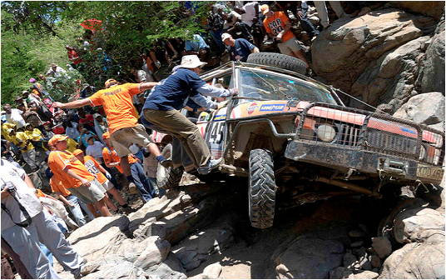
7 TRENDS
2. Nonprofit innovation coming from everywhere
Notes:
Africa is home to some very unique, world-class fundraising events attracting participants from the world
-The Rhino Charge is an annual off road motorsport competition that has been held in Kenya since 1989. Requires high level of skill in off-road driving and navigation. The event, organized by The Rhino Ark Charitable Trust, is held to raise funds for conservation of Kenya’s Aberdare Ecosystem
-Masai Mara Marathon another example of high profile fundraising event attracting international participation
Some examples of innovation from around the world:
-Micro-finance from India
-Giving circles from USA
-Social impact bonds from UK
-Face-to-face from Greenpeace in Switzerland
Examples of invigoration of existing methodologies:
-Door to door fundraising in Chile
-Telethons in South America
-Direct mail in Australia

Slide 8




7 TRENDS
3. NGOs growing everywhere; some giant INGOs emerging
Notes:
INGOS fastest growing subset in NGO sector which has been the fastest growing sector in the past 20 years
After getting its start 30 years ago in Bangladesh, BRAC is already the biggest NGO in Afghanistan, Tanzania and Uganda, overtaking British charities which have been in the latter countries for decades. Example of INGO in Southern Hemisphere spreading in the south, rather than from organization coming from the North to the South
-Grameen Bank was neither the first nor the largest microfinance lender in Bangladesh; BRAC was - disburses about $1 billion in microfinance annually. Also:
- is an internet-service provider
- runs a university
- its primary schools educate 11 percent of Bangladesh’s children
runs feed mills, chicken farms, tea plantations and packaging factories.
BRAC earns about 80 percent of the money it disburses to the poor (the remainder is aid, mostly from Western donors).
Three other example of INGOs
-World Vision, started in USA 30 years ago, faith-based, original mission to help war orphans after the Korean War
-Red Cross, founded 100+ years ago by Swiss businessman
-Doctors without Borders, relatively new, started by French physicians

Slide 9

7 TRENDS
4. Debate about roles of philanthropy and the state
Notes:
Spread of philanthropy is not universal. In Russia, Egypt, Venezuela, crackdown on NGOs

Slide 10
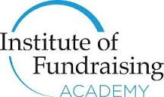
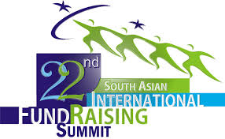


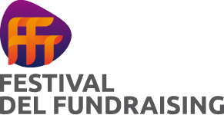
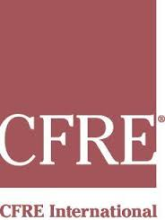

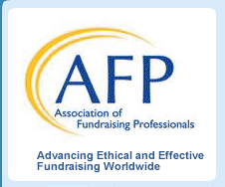


7 TRENDS
5. Fundraising becoming more professional
Notes:
Recent research by the Resource Alliance found that there are more than 20 countries around the world striving to establish professional standards and qualifications for fundraisers.
The Advanced Diploma in Fundraising is the world's only international advanced qualification in fundraising. It will be introduced in US in March at the 2014 AFP conference. Created by AFP, the Institute of Fundraising (IoF) UK and the European Fundraising Association

Slide 11

7 TRENDS
6. Technology important; no agreement on how
238 × 170 - thewakemanagency.com
Notes:
There are challenges with technology. There is no global giving platform and what should be simple philanthropic transactions between a donor in one country and a recipient in another, can be encumbered by clumsy and expensive giving vehicles. But we believe Facebook or Google will eventually develop that universal platform.
Some countries, like, India and Africa, are clear innovators in the use of technology.
Kenya pioneered mobile phone based money transfer and payment
-In 2011, Kenya was experiencing its worst drought in six decades
-Red Cross Kenyans for Kenya campaign created to raise at least $5.9 million. In four weeks raised $11.9 million
-Most of the contributions by individuals were made through mobile money transfer services
-Facebook and Twitter were catalysts for awareness and support for the campaign
-Allowed for donations as little as twelve cents (KES 10). Half its population earns less than $2 per day
Africa is growing out of being an aid recipient continent:
-There are now 100,000 African millionaires
-34 percent of the continents population is middleclass, to grow to 42 percent of the population or 1.1 billion people by 2060

Slide 12
7 TRENDS
7. Philanthropy thrives best in structured, regulated environments
Hudson Institute 2013 Index of Global Philanthropy and Remittances:
#1 USA
CAF World Giving Index 2012:
#1 Australia
Organization for Economic Cooperation and Development (OECD) 2013:
#1 Luxembourg
Big Mac Philanthropy Index 2013:
#1 Singapore
Notes:
We know that having tax incentives and ease of NGO registration, professional education and other kinds of infrastructure, help to create good environments for philanthropy
Example, India is experiencing a CSR (Corporate Social Responsibility) windfall. Companies Bill 2011, which mandates companies to spend at least two percent of their net profit on CSR
What we measure and pay attention to can change and grow. Several credible studies use different criteria for ranking national philanthropy.
-The Hudson Institute Index of Global Philanthropy and Remittances, factors Diaspora giving into its measurements, ranks the US as #1
-CAF World Giving Index 2013 includes volunteering and helping strangers in its computations, and rates USA as #1, but last year Australia was first
-The Organization for Economic Cooperation and Development (OECD) judges by the percentage of ODA compared with gross national income and identifies Luxembourg as #1 with 1 percent
-The Management Centre UK’s Big Mac Philanthropy Index 2013 accords the honor to Singapore, basing its comparisons on the local price of a Big Mac and The Economist magazine’s well-established methodology

Slide 13
7 TRENDS
Great growth in wealth
Nonprofit innovation coming from everywhere
NGOs growing everywhere; some giant INGOs emerging
Debate about roles of philanthropy and the state
Fundraising becoming more professional
Technology important; no agreement on how
Philanthropy thrives best in structured, regulated environments
Notes:
In summary these are the seven trends that we identified
Certainly Rotary International has been a leader not only in its work with polio, but showing just how dramatic world change can happen through the efforts of just one organization

