Slide 1
YOUR ROTARY RESOURCES
2014 Coordinators & Advisers Institute
7 March 2014

Slide 2
Introduction
2
Notes:
Laurie McCarthy
Good morning, my name is Laurie McCarthy and I am the Director of Member Relations.
Before we get started, I wanted to thank each of you for attending this year’s Institute. I know that this is a busy time of year and that many of you have made a lot of accommodations in your professional and personal lives to come to this training. Thank you. We’re so glad that you’re part of the second year of the adviser training.
Here with me is Christine Grodecki, Engagement Associate with the Regional Coordinator Programs. She is stepping in as your primary point of contact with Rotary Headquarters in Evanston. Melanie / Catherine / Michelle will share information regarding a wealth of resources and support. Then Melanie / Catherine / Michelle will turn it over to {insert coordinator name here} who will be talking a bit more about how he/she uses these resources in their role as a coordinator/adviser.
Before Melanie / Catherine / Michelle begins, I’d like to highlight the rest of the Regional Coordinator Program team in Evanston.

Slide 3
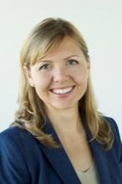
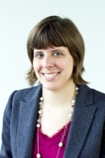
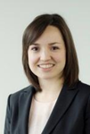
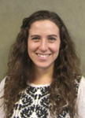
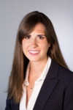
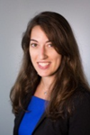
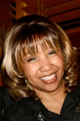
YOUR SUPPORT TEAM
Christine Sanders
Manager
Christine Grodecki
Engagement Associate
Kori Crockett
RC / RPIC Admin
Kara Zucker
E/MGA / RRFC Admin
Open
Supervisor
Catherine Lankford
RC Specialist
Michelle Gasparian
RPIC Specialist
Open
E/MGA Specialist
Melanie Davis
RRFC Specialist
3
Notes:
Here is the full Regional Coordinator Programs team – in addition to Melanie / Catherine / Michelle, you may also be contact with others in our support team. I won’t take the time here to introduce each person indvidually, but I do hope that you get to know our full group.
Our department is comprised of staff who support all the coordinator and adviser programs as well as assistant coordinators. We believe it is very important to model the teamwork that you are doing in the field with our colleagues in Evanston and in the international offices. The goal of our team is ensure the unique needs of RRFCs / RPICs/ EMGAs/ RCs group are met while capitalizing on the similar staff activities that are common across all of the programs.
In addition to working closely with my colleagues on the coordinator support team, we work with colleagues throuhgout the organization to ensure that you receive tailored support for your role.
MG: We’re continuing to work closely with our colleagues in Public Relations to support you. Although I am your primary contact, I liaise with many PR colleagues to ensure that you have access to a wealth of resources and up-to-date communications. A number of our PR colleagues are here today and we’d like to introduce them:
CL: We’re continuing to work closely with our colleagues in Membership Development and Rotary Programs. Although I am your primary contact, I work Membership and Programs to ensure that you have access to a wealth of resources and up-to-date communications. A number of our Membership and Programs colleagues are here today and I’d like to take this opportunity to introduce them:
CG: We’re continuing to work closely with our colleagues in Fund Development to support you. Although the soon to be hired EMGA specialist will be your primary contact, he or she will liaise with your existing staff partner to ensure that you have access to a wealth of resources and support. A number of our Foundation fund development colleagues are here today and we’d like to introduce them.
{read names, titles, and ask to stand}
In addition, we also work with our colleagues in the international offices to support you. Several representatives from the international offices are present and I’d like to recognize them for sharing their expertise and knowledge.
And now, I’ll turn it over to Michelle / Catherine / Melanie / Christine.

Slide 4





HOW DO WE WORK TOGETHER?
Email me at emga@rotary.org
Call me at 847.424.5211
4
Notes:
SPECIALIST
As your primary point of contact for all matters relating to your role as a coordinator, we will be working together in numerous ways/capacities. Here are some types of support that you’ll receive:
{click} Communications and updates from Rotary to you: As a liaison between you and Rotary HEADQUARTERS, I regularly share information and updates related to your role. Whenever possible, I will include guidance on how to use these materials and information about the intended audience. Examples include special messages from Rotary senior leaders, updates on initiatives and programs, copies of communications to your districts, and
E/MGA: monthly major gift reports, fundraising goals, and communications from your staff partner.
Additionally, all coordinators and advisers receive a monthly newsletter, the Coordinator Communique, with Fund Development, Rotary Grants, RI Programs, Public Relations, Polio, Alumni, and Membership updates.
{click} Promoting your role: Consider sharing updates and information regularly with district leaders in your region via a newsletter, website, or blog. This is only one of the ways that you can promote yourself and become known as the go-to resource for leaders in your region. We can provide contact information for district leaders to help facilitate your connections with them.
To help the Rotary world gain greater awareness of your role, we promote you as a resource in training publications, on Rotary's website, and through other Rotary and staff channels. Please copy me on your newsletters and keep me updated with your activities. The more we know about the work you are doing, the more we can effectively promote you.
{click} Strategy, planning and help with presentations: One strategy to establish your presences as the go-to resource in your region is through presentations and training sessions. We work to provide you with the most up to date materials and resources available from Rotary to use in your presentations and training sessions. Additionally, I am always available to review any materials you develop. If there is a presentation or speech coming up, I am happy to brainstorm and strategize with you. I am also more than happy to assist you with any challenges that may arise in your zone or relating to your roles.
{click} Expense reports & Travel Requests: You will be travelling during your term as a adviser. As your specialist, I’ll be assisting with the travel approval and expense reimbursement process. When you submit travel requests remember to copy me on the initial request and send your expense reports directly to the EMGA mailbox along with any required proof of payment or documentation. We’ll discuss this process more in depth a little later.
{click} Allocation support: You’ll want to track your expenses to ensure your allocation funds will cover your expenses. If you are running low on funds and absolutely have to attend an event coming up, let me know ahead of time so we can work together on a solution. For more tips on managing your allocation, I encourage you to review our recent webinar recordings.
{click} I am available to answer any EMGA questions in general and can be reached by e-mail, phone (or Skype).
Next let’s review some additional resources that you’ll use as a coordinator / adviser.

Slide 5
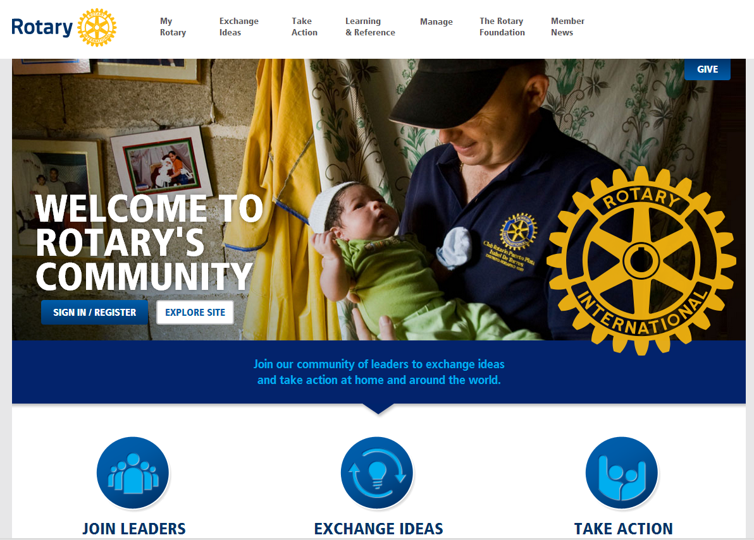
ROTARY’S WEBSITE
5
Notes:
SPECIALIST
As you know, Rotary’s updated website launched in September 2013. The new site has lots of tools and resources that can help you in your role as an adviser. Have you created an account on Rotary.org?
If you haven’t created an account yet, I encourage you to make one right away in order to access specific content available for advisers. Michel Monteau will be talking more about how he uses
In the next few slides, I’ll highlight some specific tools and resources on rotary.org that are relevant for your role.

Slide 6
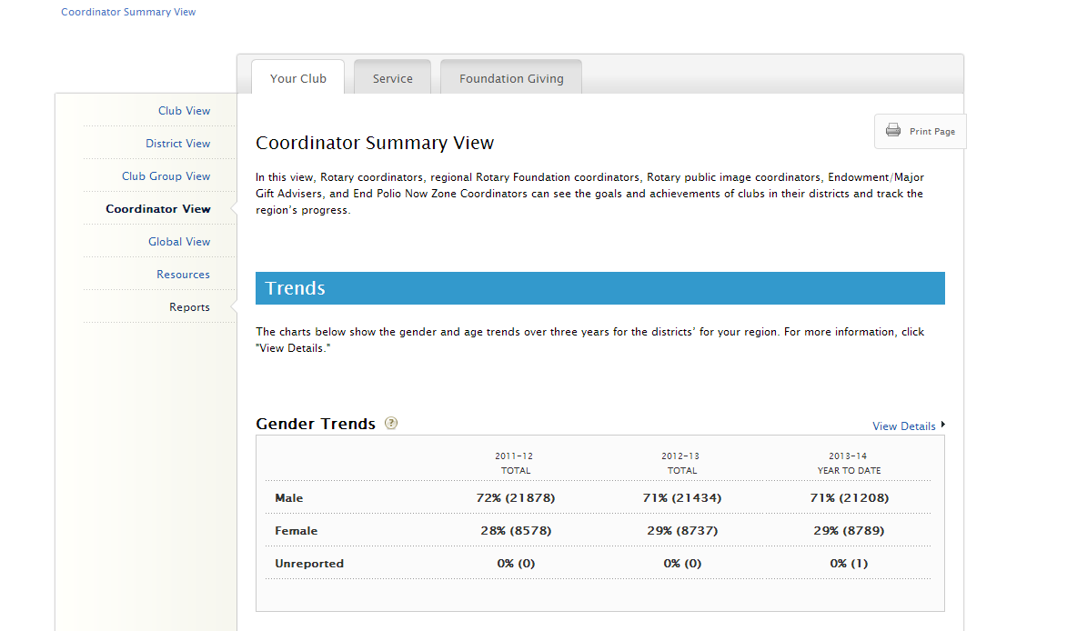
COORDINATOR VIEW IN ROTARY CLUB CENTRAL
6
Notes:
SPECIALIST
One key resource that you’ll find when you log into Rotary’s web site is Rotary Club Central, an online tool designed to help clubs set goals and track their accomplishments online. As an adviser, you , you can see the goals and progress of all clubs in your districts, both on an individual club basis and as an overall perspective through a “Coordinator view” designed specifically for regional leaders. By toggling between the three tabs at the top, “Your Club”, “Service” and “Foundation Giving” you will be able to see graphs and trends for your region based on goals set by clubs in your region.

Slide 7
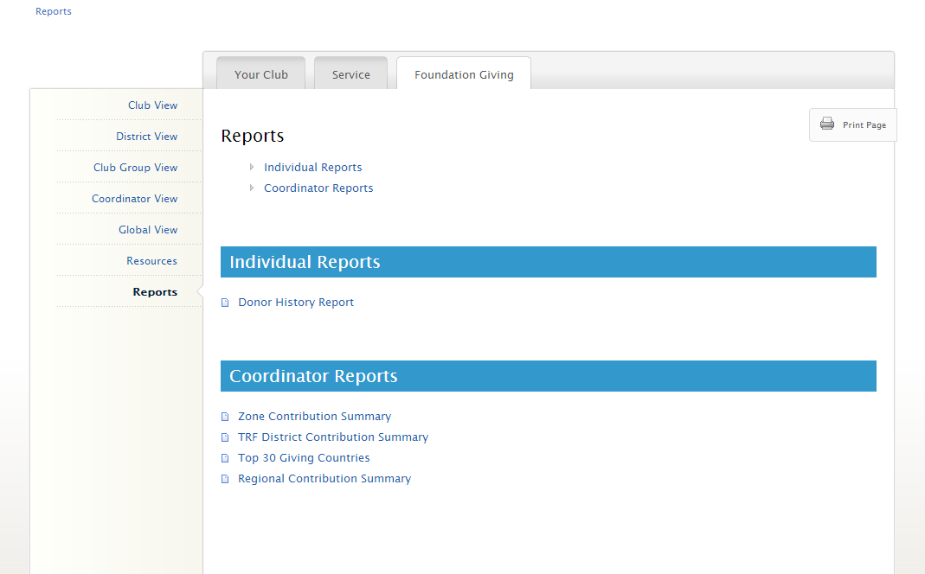
REPORTS
7
Notes:
SPECIALIST
One of the features that you as EMGAs will find the most useful are available Rotary Foundation reports.
The Zone Contribution summary ranks district contributions in each region around the world.
The TRF District contribution summary lists contribution information for each district.
The top 30 giving countries report is useful for analyzing contribution trends for countries.
And the regional contribution summary which has a high-level overview of regional trends. This report is useful for analyzing contribution trends with regional totals that are not included in the TRF financial statements

Slide 8
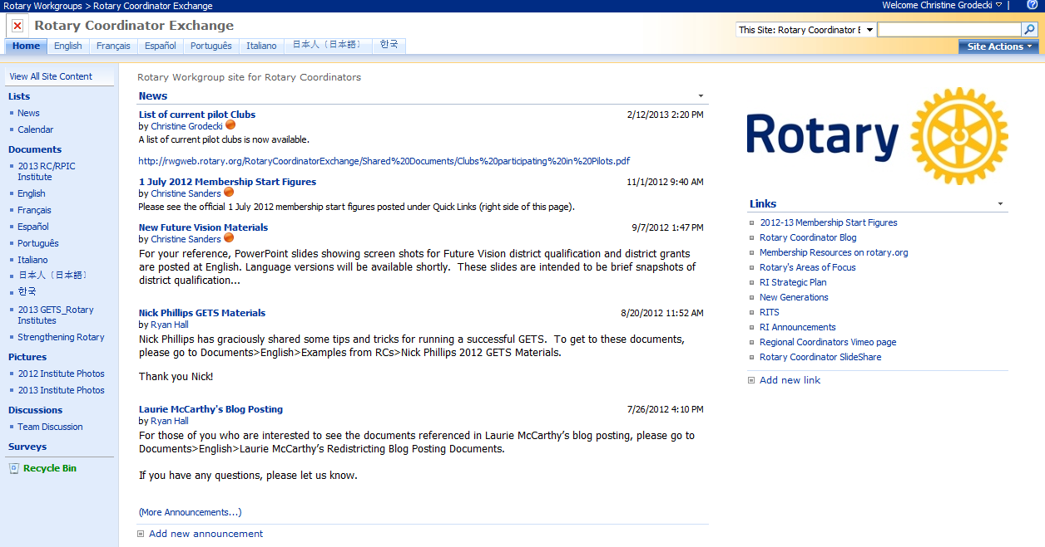
YOUR ROTARY WORKGROUP
8
Notes:
SPECIALIST
Another tool available to you through the new website is your Rotary Workgroup.
After logging in to the website, on your profile page you will find a link to Rotary Workgroups. By clicking on the link, you can access your E/MGA Exchange. This is a tool designed to facilitate sharing of resources and materials not only between Rotary and you but also amongst yourselves. This is the first place to look for materials for presentations or training sessions.
Consider sharing the your presentations and materials with your fellow coordinators through the E/MGA Exchange.

Slide 9
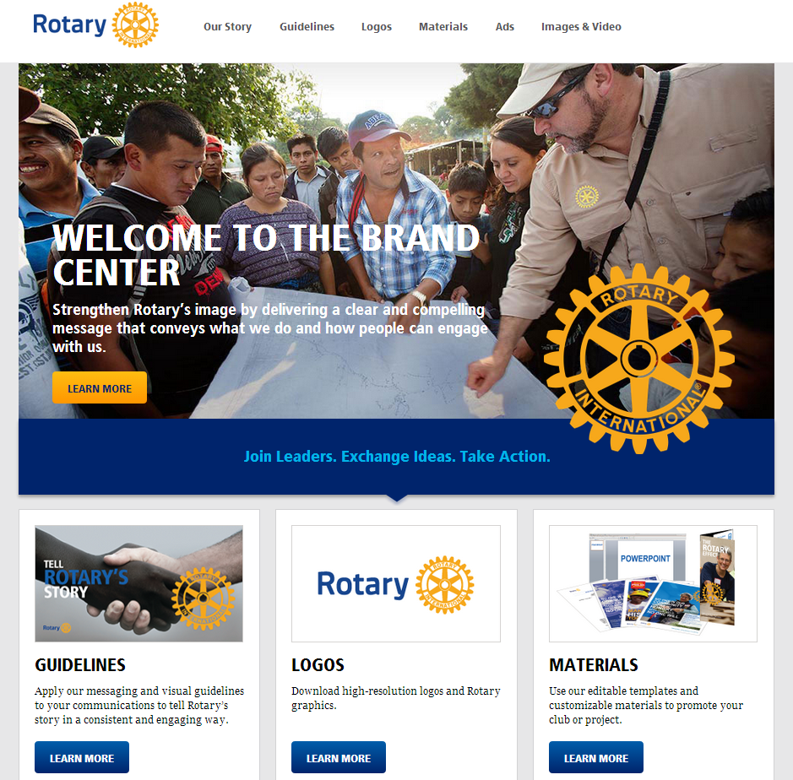
BRAND CENTER
9
Notes:
SPECIALIST
Let’s move on to the Brand center, which some of you have already explored. In January, Rotary launched a beta version of the brand center on rotary.org. This is where Rotarians can access logos, guidelines, images, videos, advertisements, and other resources to help them tell Rotary’s story better than ever before, both in our own communities and around the world. More than sixty Rotarians participated in testing this tool. This first version of the microsite was released in eight languages. The brand center will continue to be developed throughout this year, so please consider sharing your suggestions via the “Feedback” button on the website.

Slide 10
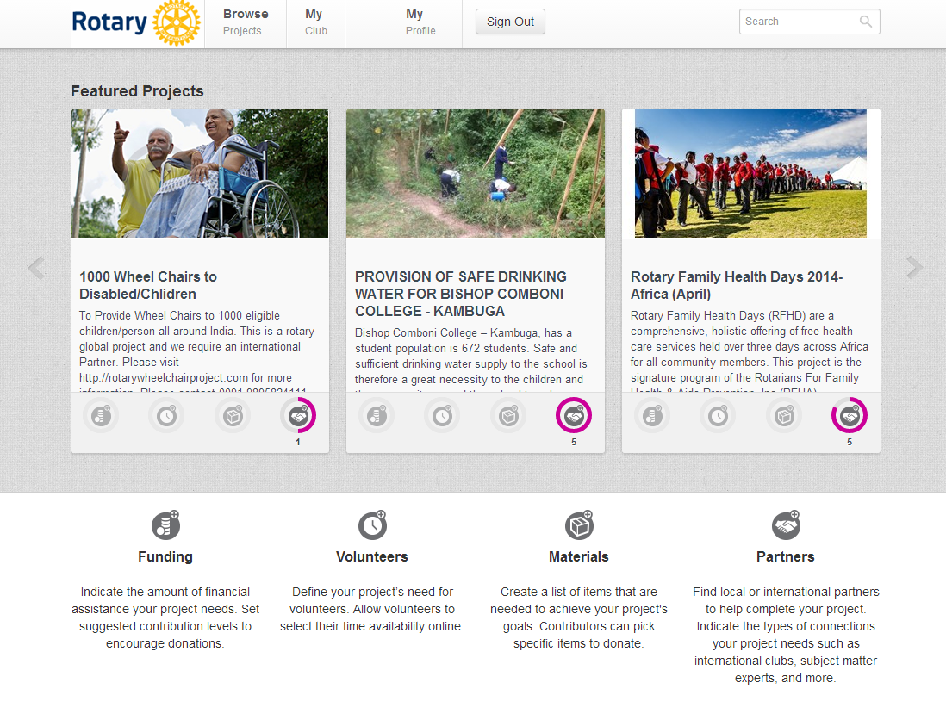
IDEA PLATFORM
10
Notes:
SPECIALIST
Idea platform is one of Rotary’s newest online tools. How many of you have explored Idea platform?
As some of you know, Idea Platform is a crowdsourcing platform designed to help districts and clubs find local or international partners, volunteers, funds, and materials to help support them complete their projects. As an adviser, you can use support the Miles to End Polio challenge, browse projects, or promote service projects in need of resources on ideas.rotary.org.

Slide 11
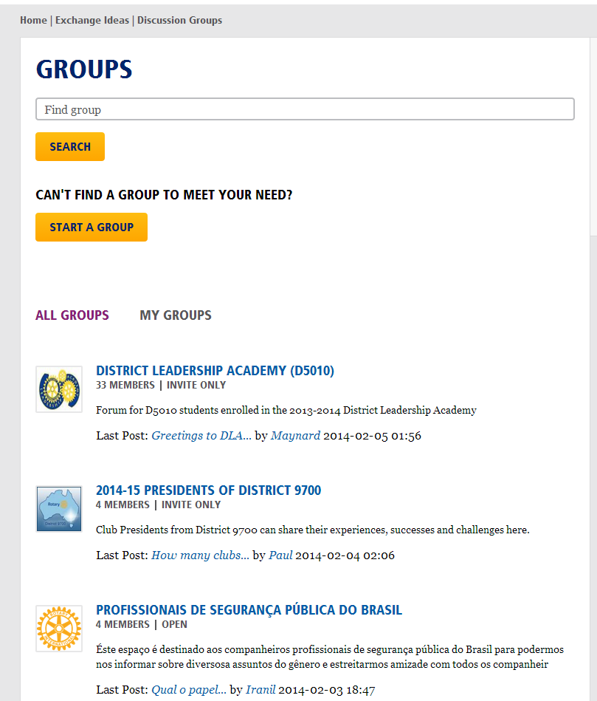
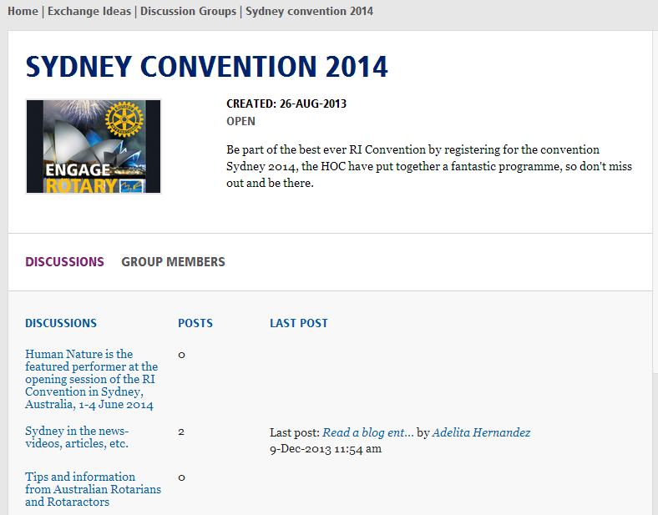
DISCUSSION GROUPS
11
Notes:
SPECIALIST
Another new online tool are discussion groups. Who has participated in a discussion on Rotary.org?
By joining one of approximately 400 groups already on My Rotary you can share an interesting article on Polio in the End Polio Now group, connect with others who are attending the International Convention in Sydney or discuss Rotary Friendship Exchange.

Slide 12
Other resources
12
Notes:
SPECIALIST
In addition to the resources available on Rotary’s website, there are some additional resources we created just for you.

Slide 13
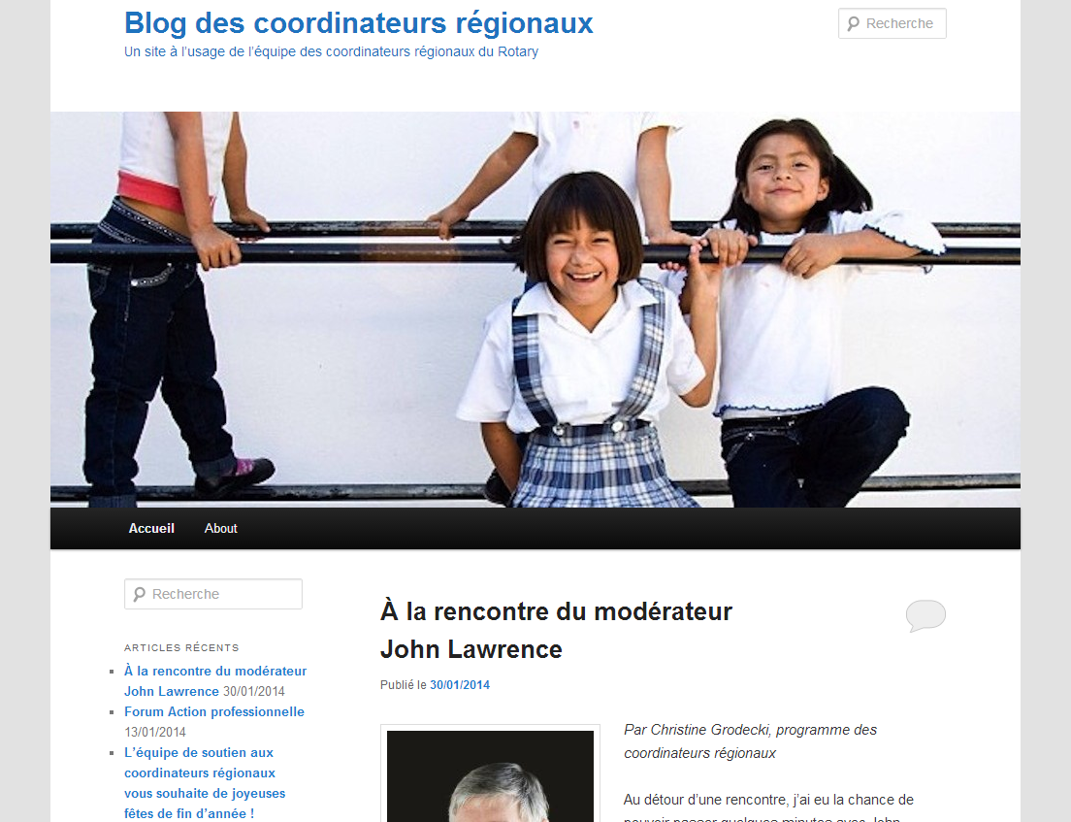
REGIONAL COORDINATOR BLOG
13
Notes:
SPECIALIST
The Regional Coordinator Blog is a public site and is available in six languages; it’s purpose is to promote the activities and ideas of the regional coordinators while highlighting you as a resource. This blog links to other coordinator blogs and websites, sharing the messages even further.
As an adviser, we hope to start sharing your successes on the blog soon. If you are doing something exciting in your zone or want to write a post, please submit it to us!

Slide 14
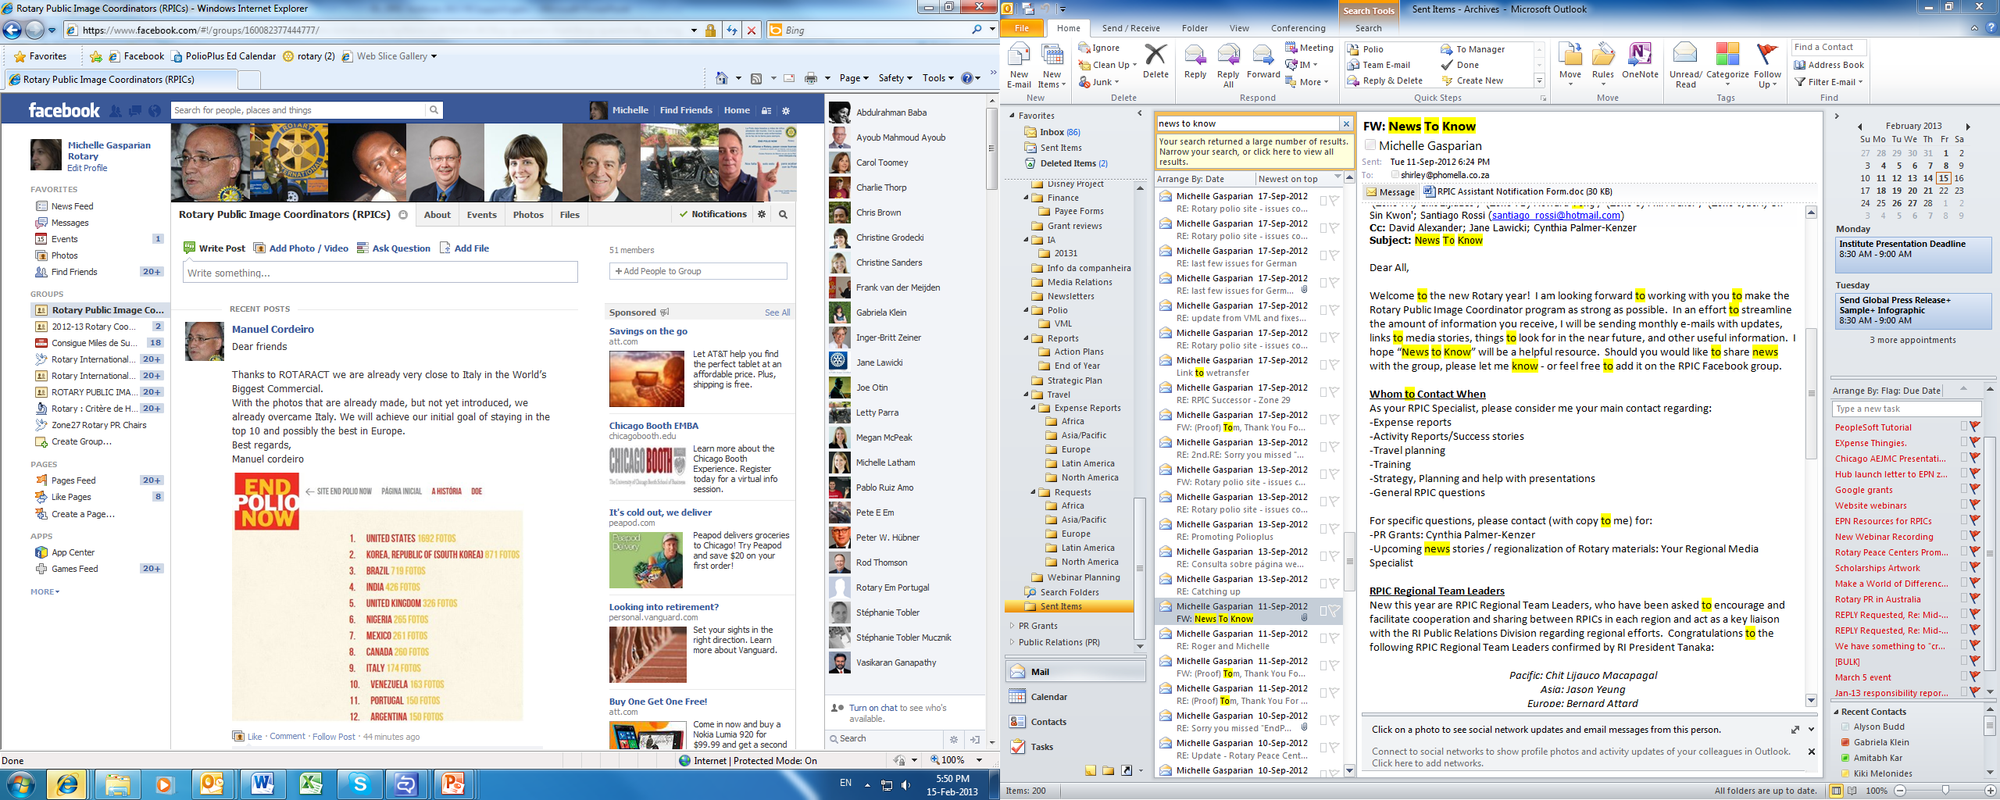
FACEBOOK GROUP
Notes:
SPECIALIST
A Facebook group was recently created for EMGAs to have a forum where you can share information, photos and ideas in private. Use this group to engage in private conversations with fellow advisers. In addition to sharing successes and materials developed in their region, some coordinators have used the groups to share challenges and ask for suggestions and tips from fellow coordinators.
Because it is secret Facebook group, your discussions are only seen by your fellow coordinators or advisers in the group, not by all of your Facebook friends. You’re not able to “share” any posts containing original information on your own profile page or in other groups.
After the Institute, we’ll be friending you on Facebook. Once you accept my friend request, I will add you to the secret group to get the conversation started.
If you do not currently have a Facebook account and wish to set one up but aren’t sure where to get started, we can direct you to learning tools that will help you create an account. We understand that not everyone is present on Facebook (nor wants to be); any important information that is shared from Rotary headquarters on the Facebook groups will also be sent via e-mail or posted to your workgroup.

Slide 15
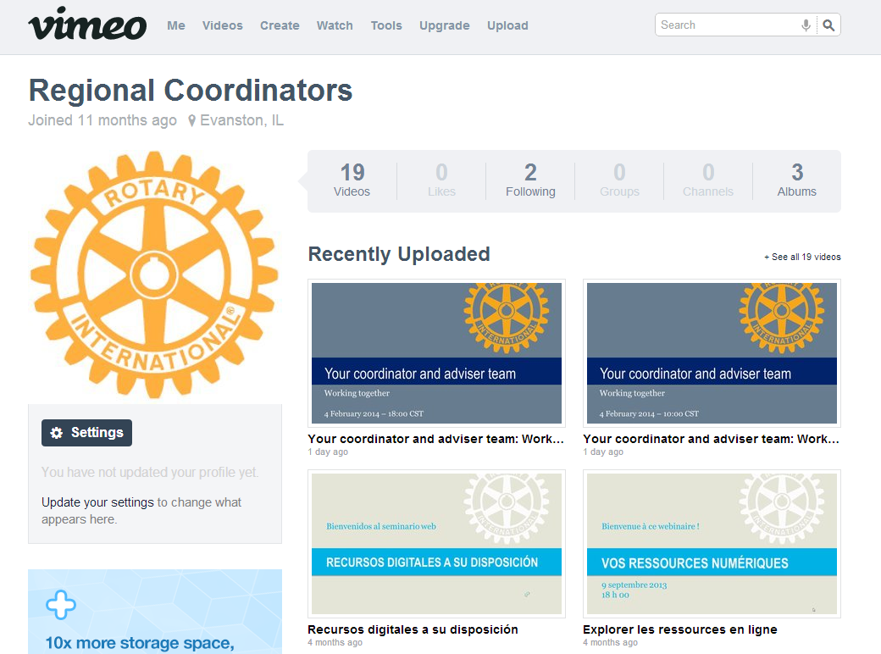
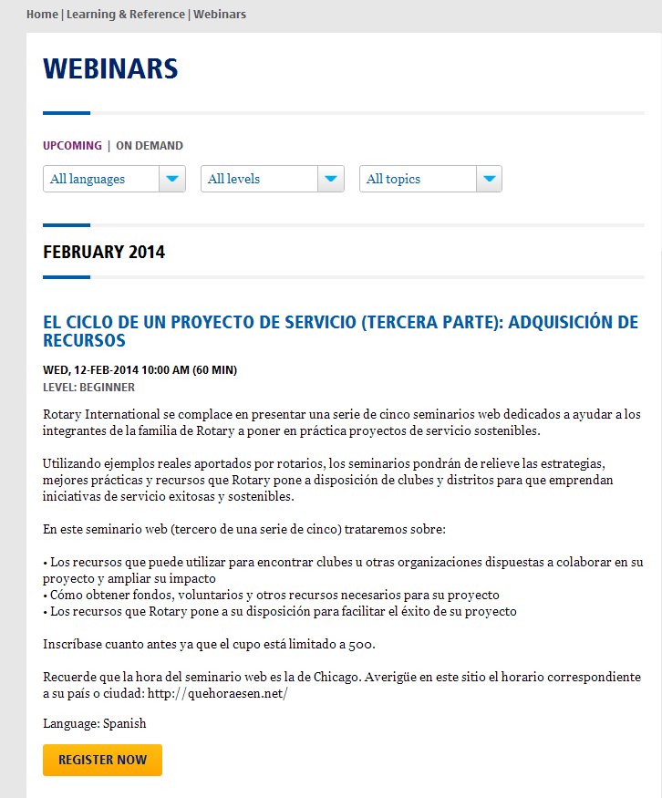
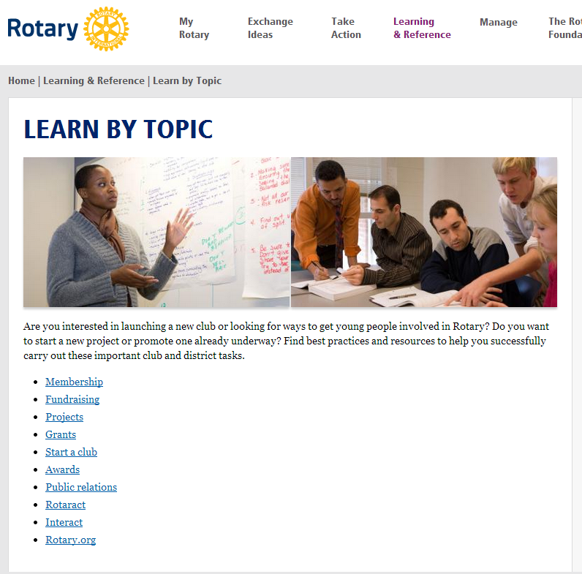
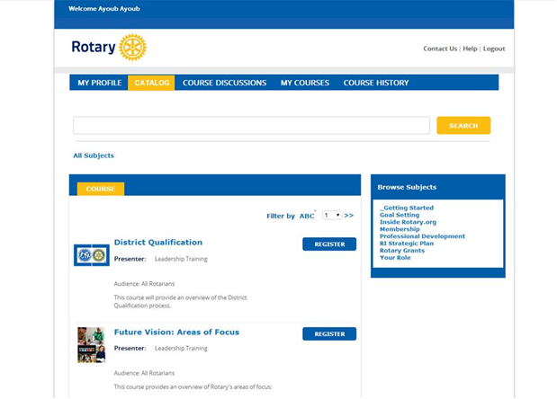
TRAINING RESOURCES
15
Notes:
SPECIALIST
Now, let’s talk about some Rotary resources that you can use for training district leaders. Many of these resources have useful knowledge for all Rotarians and some are designed specifically to address to unique needs of your group.
On Rotary’s website, under Learning and Reference is where you can find high-level information about various topics and resources that can be used in your district and regional trainings.
{click} Another great resource on Rotary’s website is the Rotary webinars page. During the Rotary year, we produce many webinars. We try to share registration information about Rotary webinars with you before they occur. But whether you are preparing for a training or just want to know more about a specific topic, you can visit the Rotary Webinars page to register for upcoming webinars and view recordings of past webinars.
{click} Our staff team produces quarterly webinars designed specifically to meet the unique needs of your group. Some of you may have had the opportunity to attend the pre-Institute webinar held in early February for incoming coordinators and advisers. All of our webinar recordings are stored on the Regional Coordinator Vimeo page.
{click} A fourth resource is Rotary’s Learning Center. Resources will be added to this site over the next few months, making it more robust, including a course on social media and strategy. Visit learn.rotary.org to walk through the site.

Slide 16
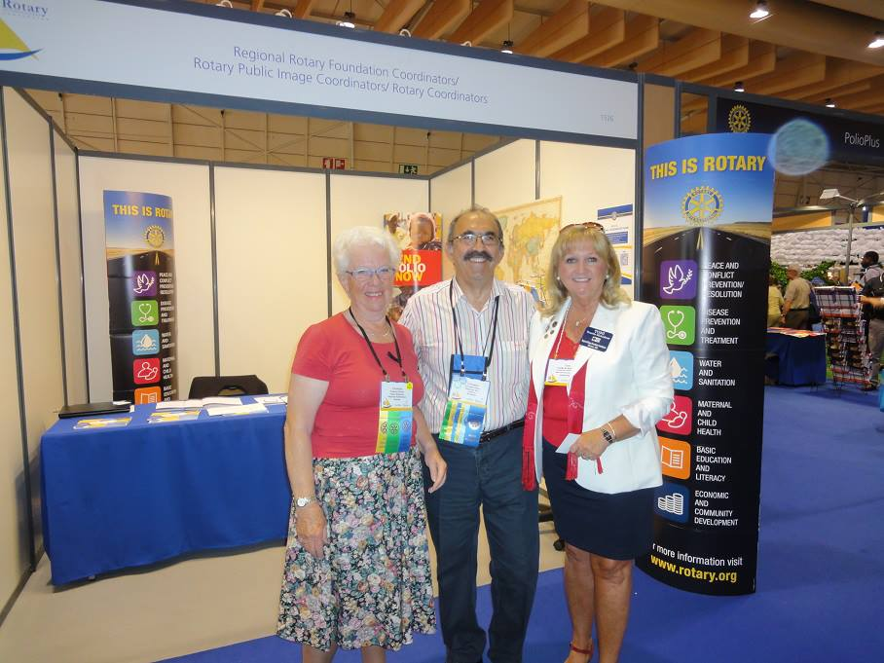



COORDINATOR ACTIVITIES
As a coordinator, you are asked to:
Complete a quarterly activity survey
Book your travel via RITS
Submit expense reports in a timely manner
Manage your allocation
Report your assistant appointments
16
Notes:
SPECIALIST
Now that we’ve covered some resources designed to support you, let’s go over a few activities that you’ll do throughout the year as an adviser. We covered most of this information in the pre-Institute webinar, so this is just a quick review.
{click} It’s important that we provide quality and detailed measurements on activities taking place in your region. You all do tremendous work and we want to share your impact with Rotary leaders and others.
You are expected to complete a Periodic report which is an online survey distributed via email; once you complete the survey your responses will be automatically returned to us. Included in this report is a prospect list template. This template will be covered more deeply in the next session but keep in mind that creating your prospect list will help The Rotary Foundation keep track of your progress and ensure good communication between advisers and staff partners
When we send out the survey we’ll include a due date.
If you have newsletters or other information you wish to provide along with the report, you can email them to me.
{click} When you are working with RITS, before you finalize your travel plans, remember to always
1) Ask for RITS APPROVAL on all air travel, regardless of the cost of the flight. Remember that if you wish to purchase your own airfare, RITS approval is still required.
2) Ask for RITS approval on any roundtrip drive of US$350 or more.
{click} To assist us with processing your expense reports quickly and efficiently, you should submit a request for reimbursement within sixty days of incurring the expense. If you are not sure of the remaining balance or whether a particular activity is eligible for reimbursement, please reach out to me. Also, please remember, if you don’t use all of your allocation, the balance does not role over to the next year.
Your allocation is designed to cover expenses related to your adviser role. As you are aware your program is still in the pilot phase and has limited funding. We want you to be able to attend Rotary Institutes or GETS but hope you understand that with the limited funds, we mostly likely will not be able to reimburse you in full for costs associated with these two events. When the program transitions out of the pilot phase, funding levels will be considered to match those of the other programs.
Allocations for 2014-15 will soon be reviewed by the Finance Committee. Once they are approved by the Board / Trustees, I will send each of you a document detailing your total allocation for the year.
If you were not able to attend the webinar in February, we encourage you to review the recording on the Regional Coordinator Programs Vimeo page. We also encourage everyone to review expense reporting guidelines and the expense reporting e-learning module.
{click} Finally, have fun with your role and get to know your fellow coordinators and advisers. How many of you are planning on attending convention? One great opportunity for you all to work together promoting your role to the Rotary world is at the International Convention where there will be a joint coordinator and adviser booth. If you are interested in volunteering in some capacity at the booth, find Christine Grodecki after this session.
And now, I turn it over to Michel Monteau who will share some tips on using these Rotary resources in your role as a EMGA.

