Slide 1
Online Resources
Michel Monteau
Friday, 7 March
Notes:
Thank you Christine. Over the past few years I have found online tools very useful and I am excited to see that Rotary continues to add more tools for us to use. I would like to share some of my favorite aspects of the new web site that assist me in my role.

Slide 2
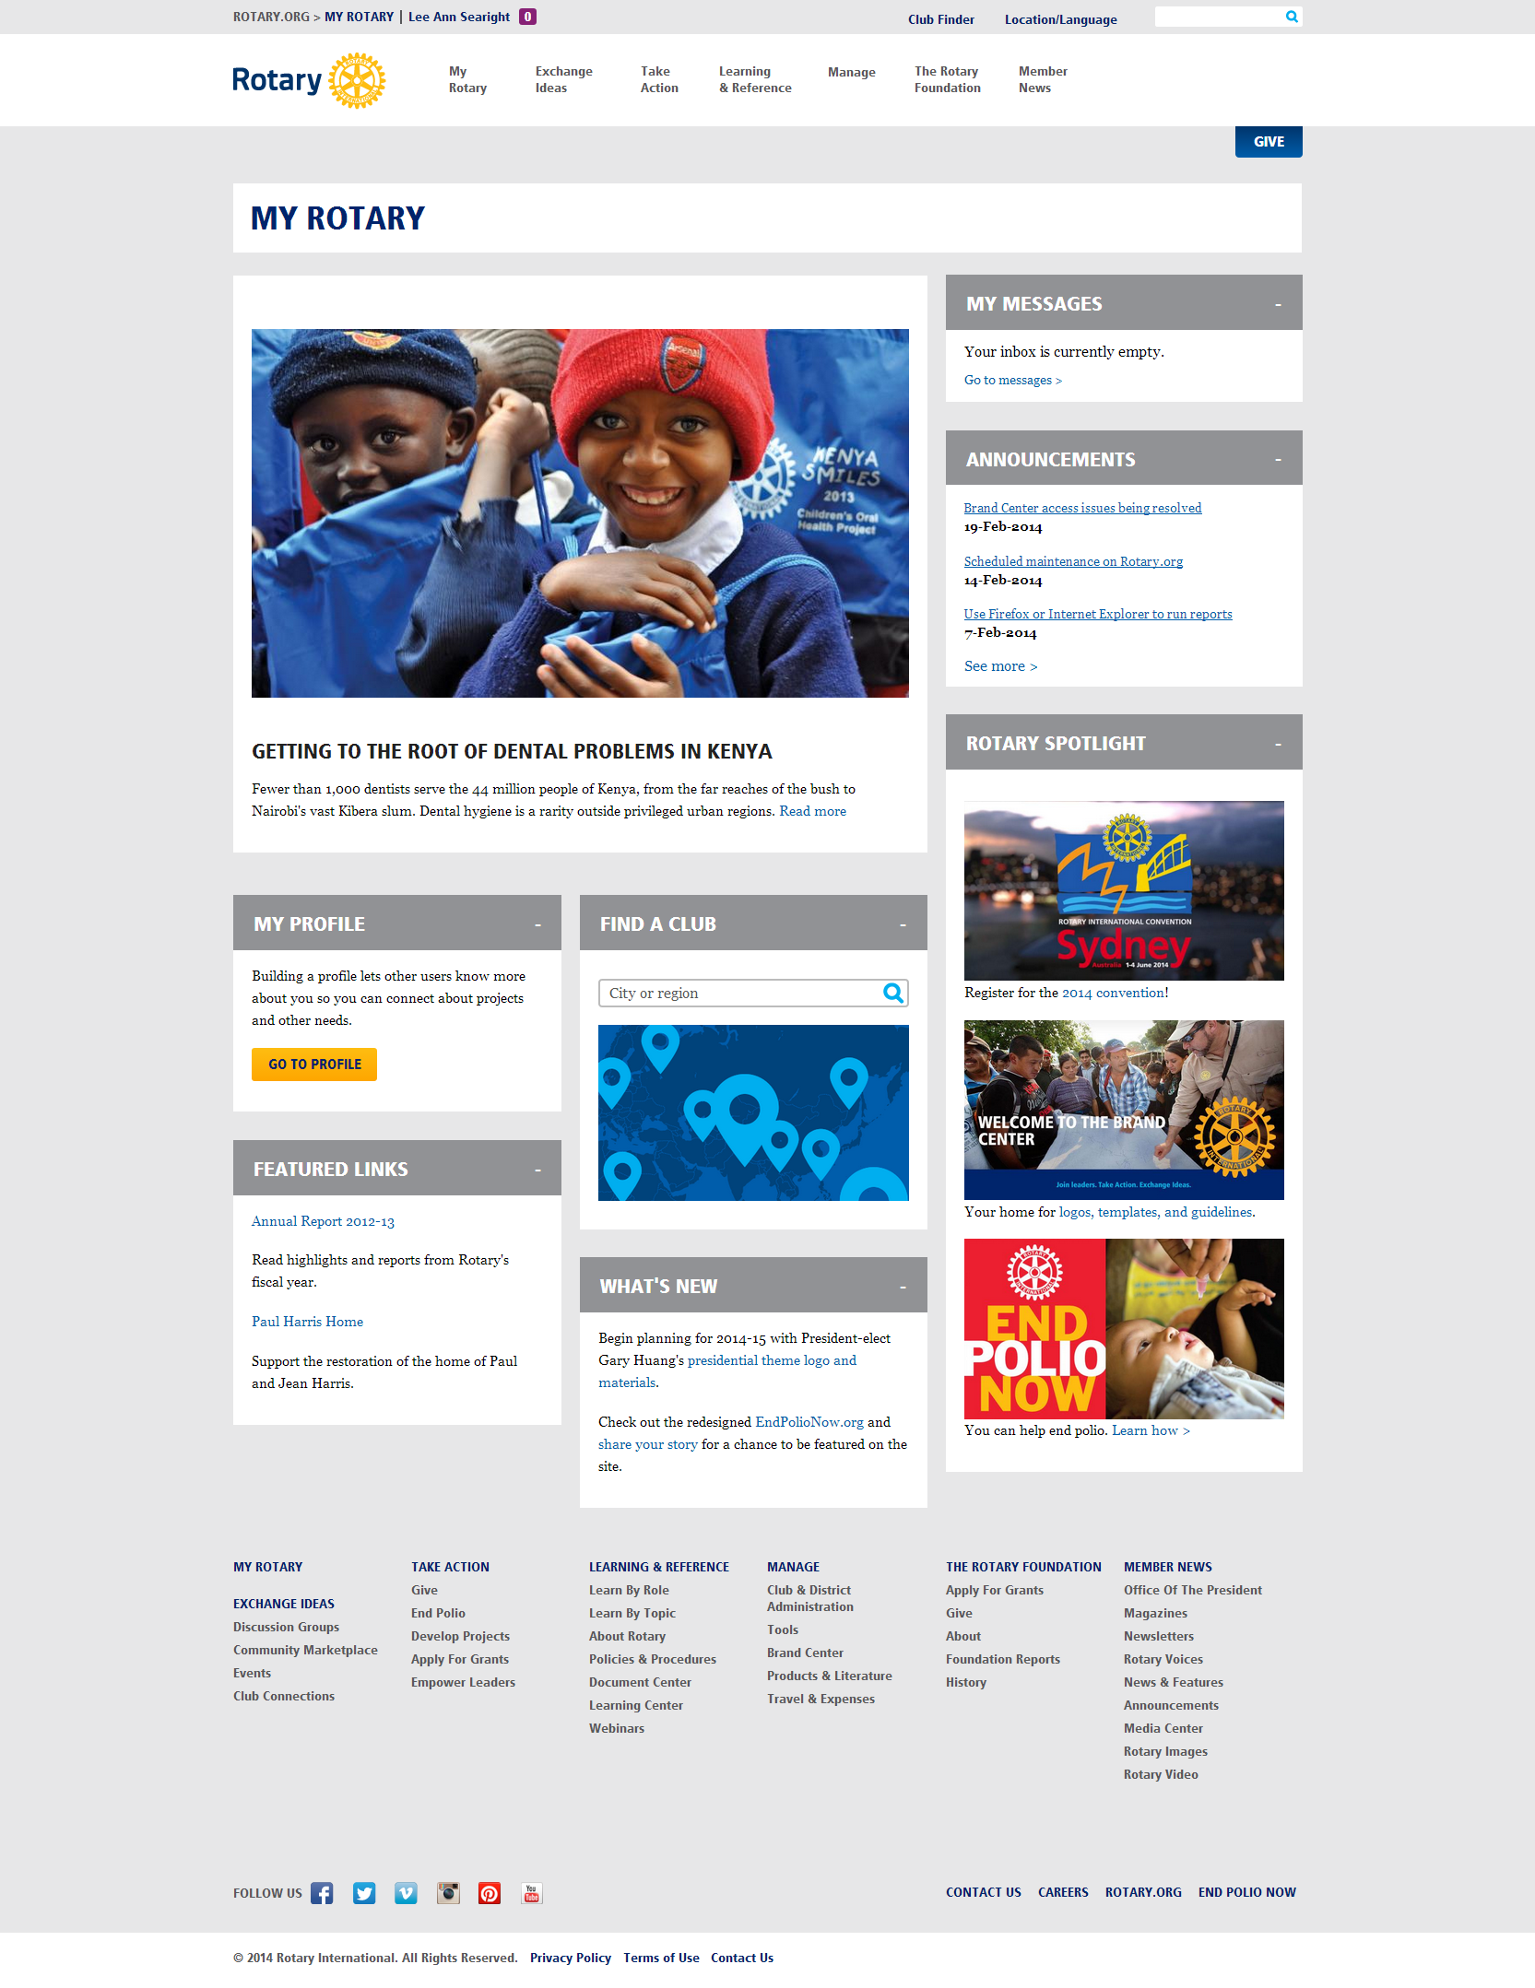

Notes:
The My Rotary is a great resource to us and I keep it at hand most of the time.
I find that it is important to have the most current information as I am very often asked for advise on program matters, and I have to be aware of the latest developments. This is a good opportunity to call fund raising to the mind of my prospective donor, The Announcements (click), What’s New (click) and Featured Links Tabs (click) , when checked frequently , bring a wealth of information .

Slide 3
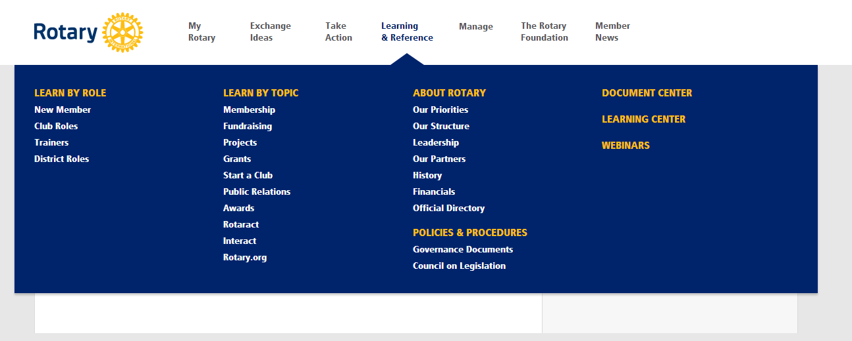
Learning & Reference
Notes:
Then there is the Learning and Reference page. Particularly the ABOUT ROTARY TAB ,one can find there , better than ever before , a clear and extensive information about all legal and financial decisions. I often get questions about the soundness of the management of our Foundation and the charts in this chapter I often use for my presentations. I am also happy to refer Rotarians to this page, as I often have complaints about alleged lack of information.

Slide 4
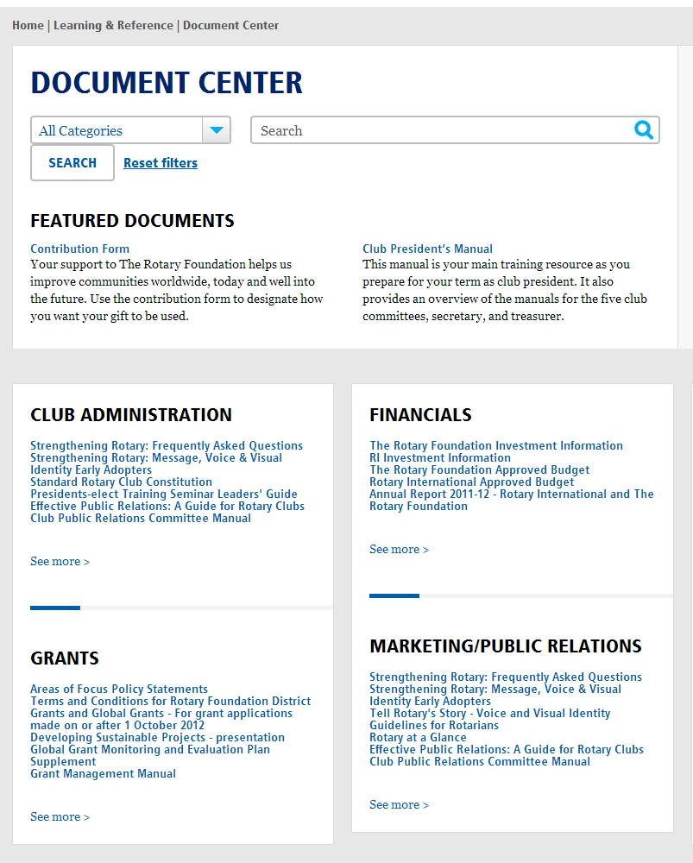
Document Center
Notes:
The Document Center is a tremendous resource. (click) The files and chapters are well organized, and one can easily reach and download the document looked for. The search engine is well designed and I no longer need to go through Google to gain time.

Slide 5
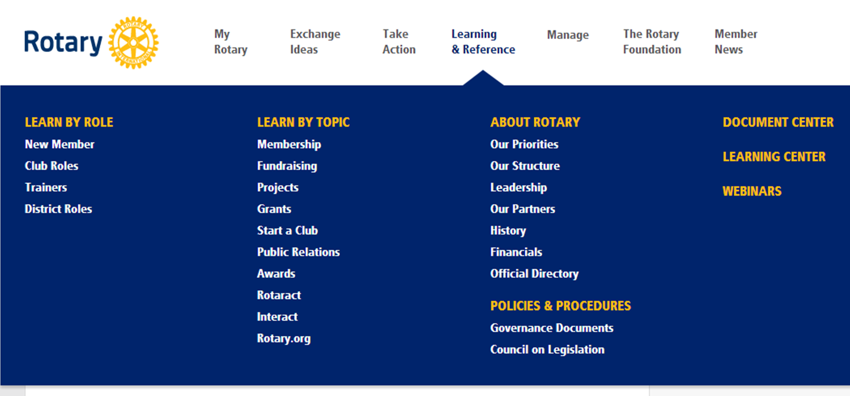

Learning Center
Notes:
There is also a course for us in the Learning Center . There is a course specific to our role and there a lot of Rotary Grant focused courses where you could learn more about district and global grants to help with your conversations with donors.
We have access to all of the webinars listed on this page and in addition, there are coordinator and adviser specific webinars that we will be invited to in order to receive updates.

Slide 6
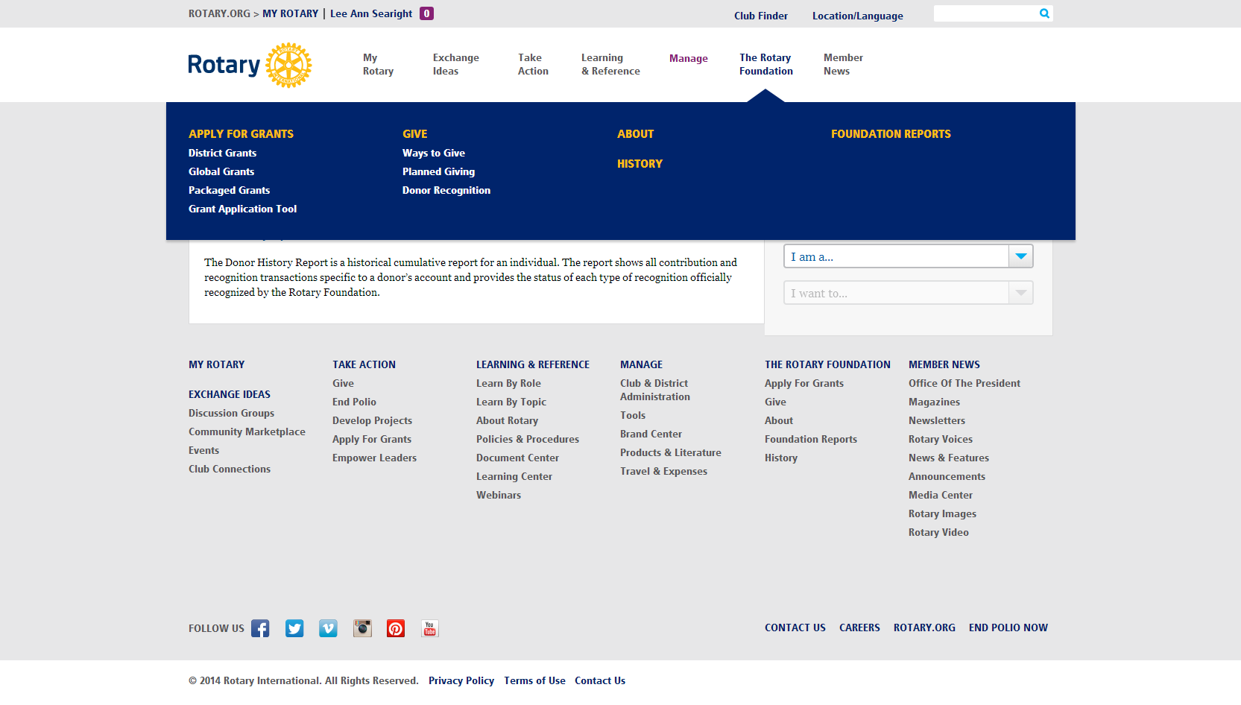
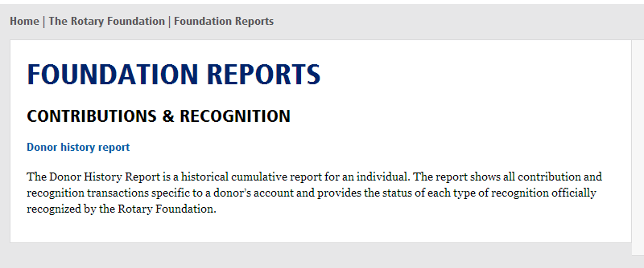
Foundation Reports
Notes:
Then there is the ROTARY FOUNDATION TAB FOUNDATION REPORTS where you access to the Reports you need , when you want to learn more about a district or discuss strategy

Slide 7
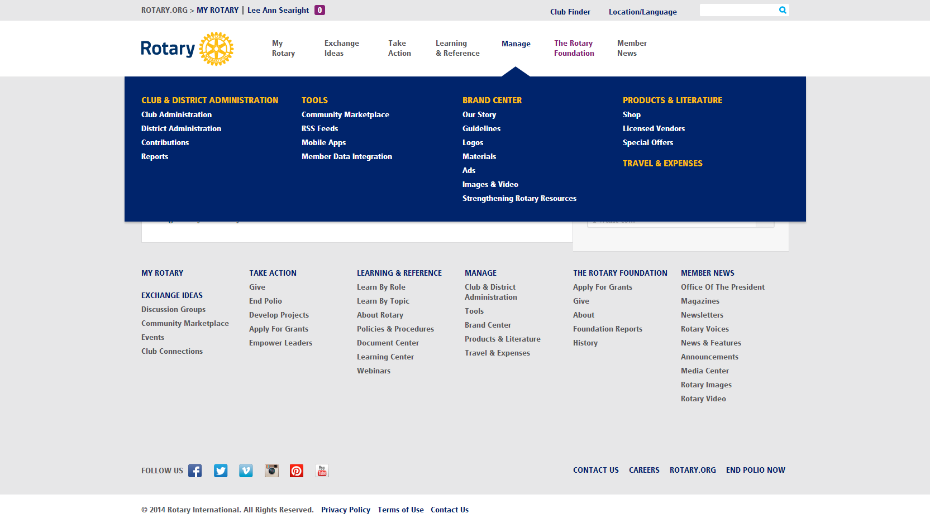
The Brand Center
Notes:
Lastly there is the new Brand Center, a great library for images , new logos, and videos, where you are almost certain to find the right picture for your favorite presentations.(

Slide 8
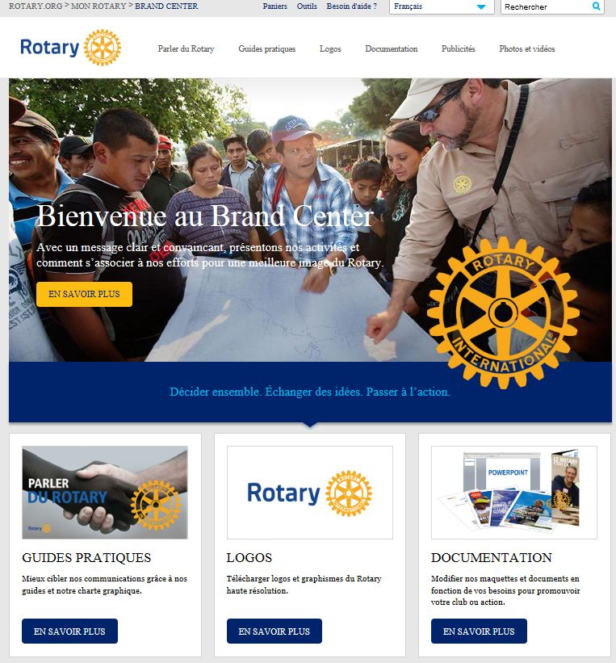
Brand Center

Slide 9
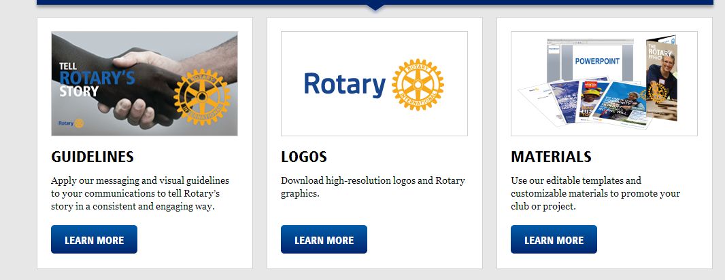
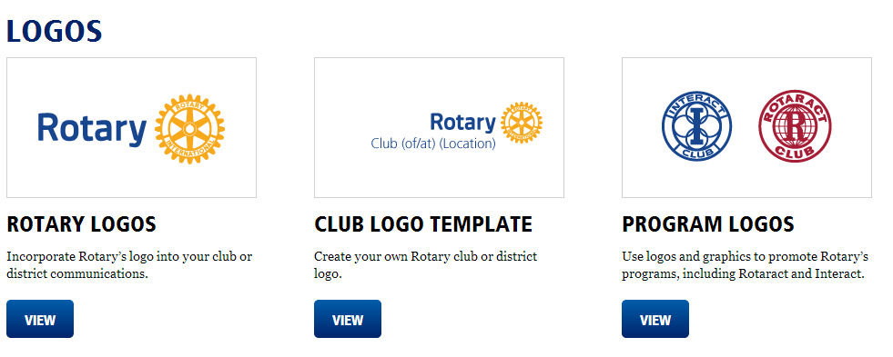
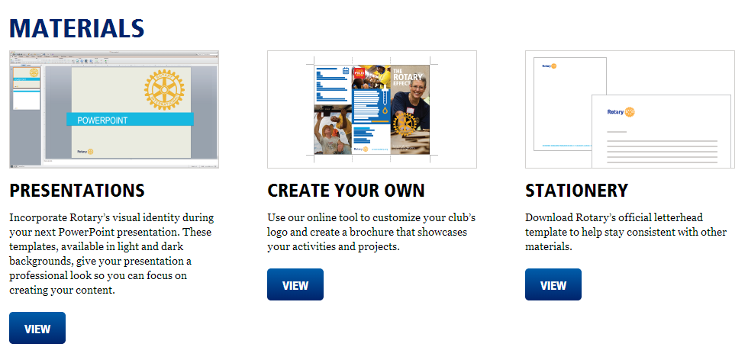
Notes:
I am stIll learning and I am far from mastering all the features of this website. I am sure many of you can add to this experience. If you are not familiar with all that the web site has to offer yet, I highly recommend taking time to explore it.

