Slide 1

Rotary’s Investment in Peace
Amy Kay
Rotary World Peace Fellow, Class I, University of Queensland, Australia
Rotary Ambassadorial Scholar, 2000, American University in Cairo, Egypt

Slide 2
PROGRAM OBJECTIVES
The Purpose of the Rotary World Peace Fellowship Program is to:
Advance research, teaching, publication, and knowledge of issues of peace, goodwill, causes of conflict, and world understanding
Provide advanced international educational opportunities for a group of Rotary World Peace Fellows chosen from different countries and cultures on the basis of their potential as leaders in government, business, education, media, and other professions
Provide a means for The Rotary Foundation and Rotary clubs to increase their effectiveness in promoting greater tolerance and cooperation among peoples, leading to world understanding and peace.

Slide 3
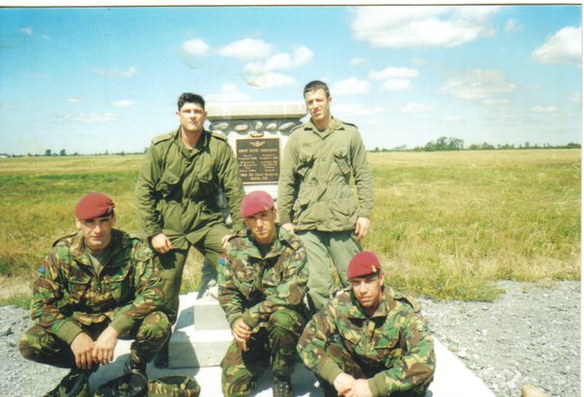
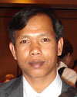


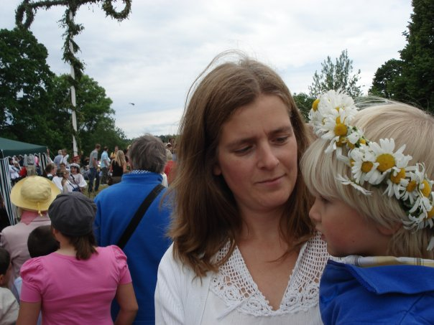

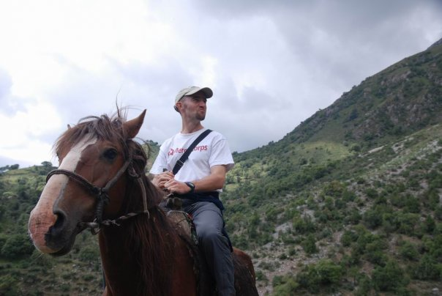
Peace Fellows Today

Slide 4


Slide 5
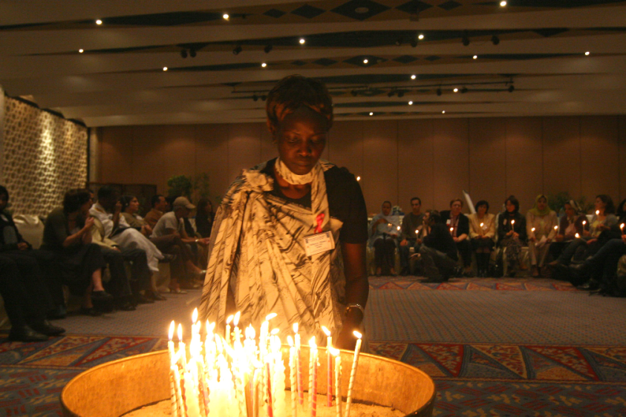
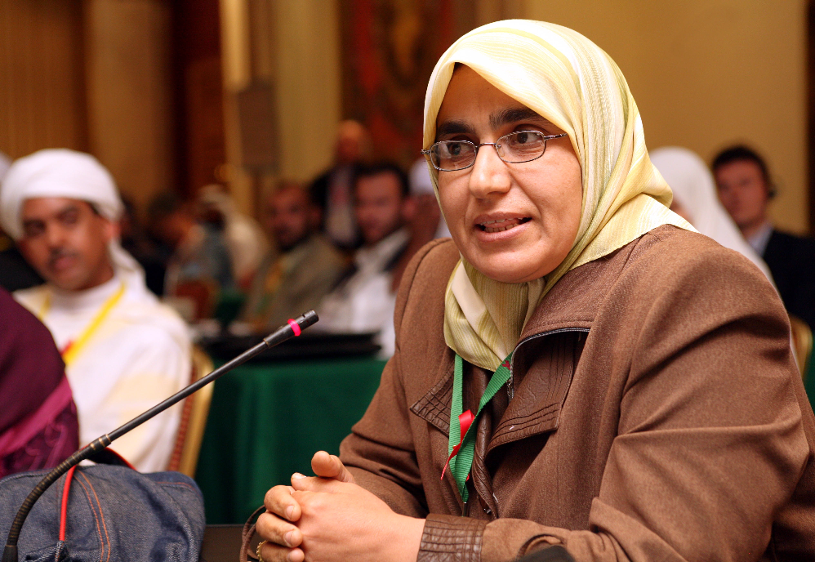
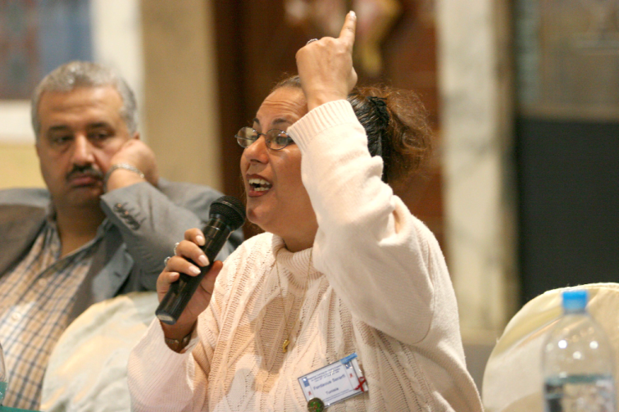

Slide 6
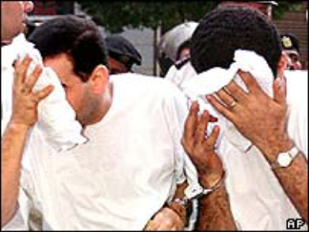
HIV and Human Rights in the Region
Libya: Health Workers Released, but Serious Abuses Remain
Egypt: Police ‘Widen HIV Arrests'
To send these men to prison because of their HIV status is inhuman and unjust. Police, prosecutors, and doctors have already abused them and violated their most basic rights, and now fear has trumped justice in a court of law. Joe Amon, director of the HIV/AIDS program at Human Rights Watch
The release of the six foreign healthcare workers is a welcome step, but others remain in prison after torture and unfair trials, including political prisoners. Libyan authorities need to reform the judicial system that unjustly imprisoned these health workers for more than eight years. Sarah Leah Whitson, Middle East and North Africa director of Human Rights Watch
Iran: Release Detained HIV/AIDS Experts
Arrested Physicians Have Not Been Charged, Whereabouts Unknown

Slide 7
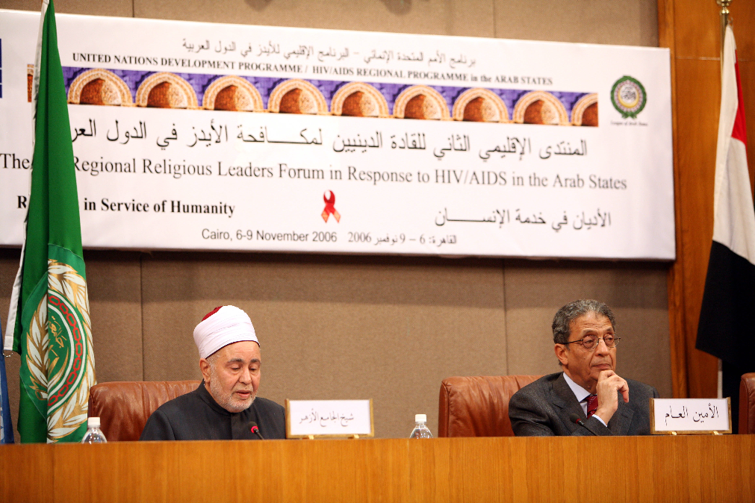
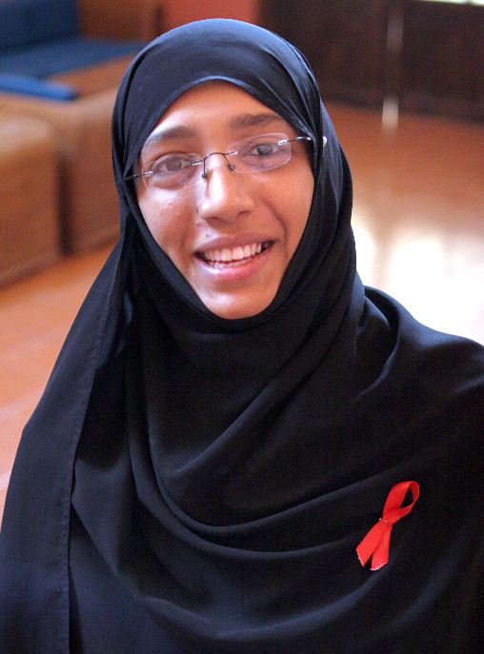
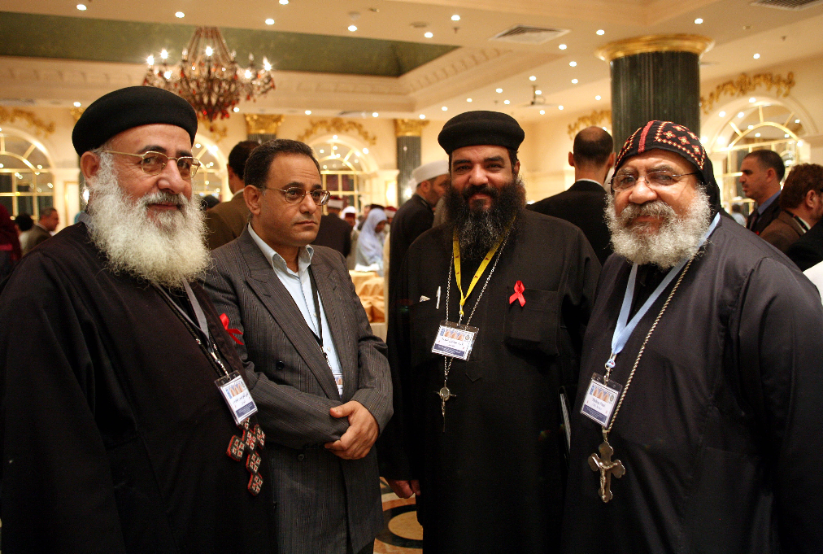
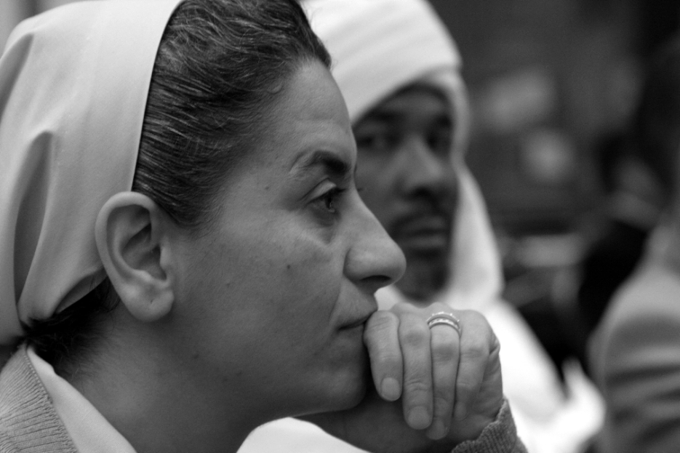

Slide 8

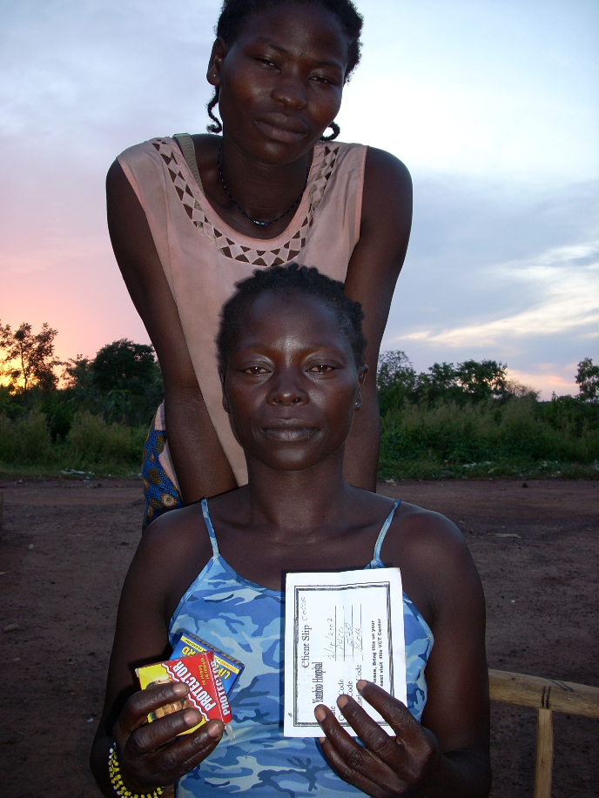
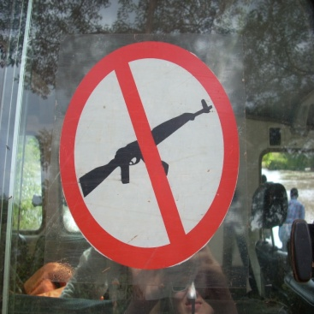
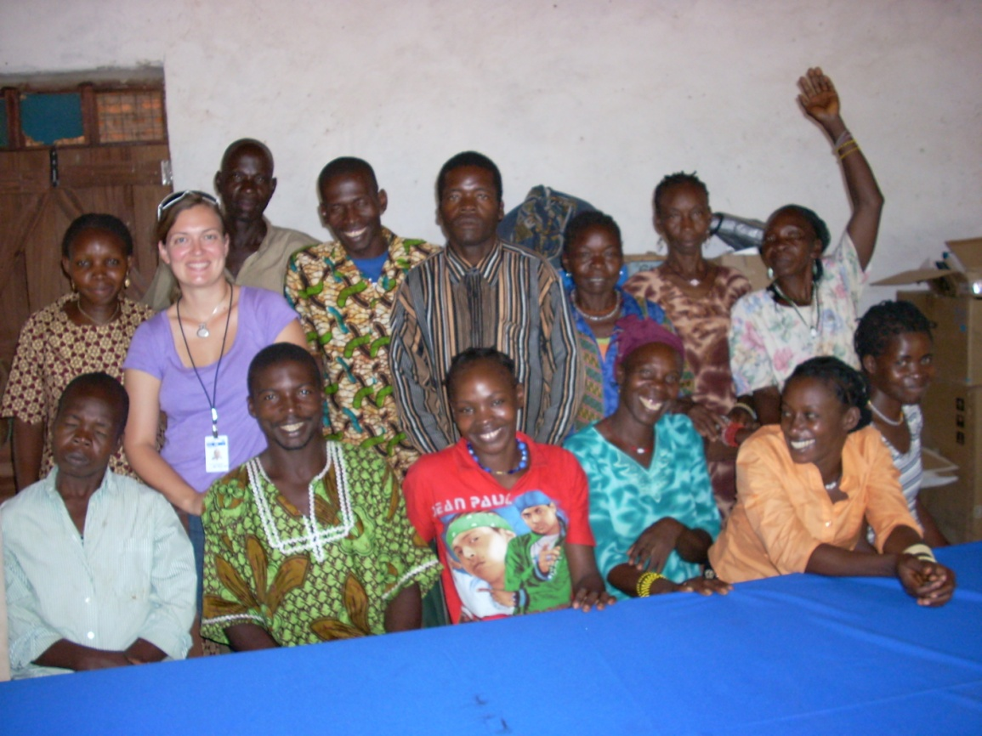

Slide 9


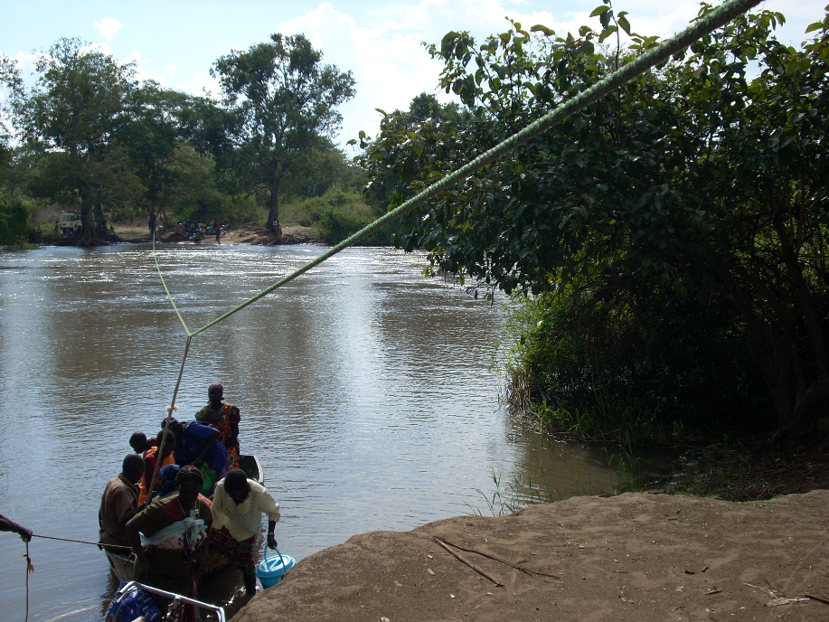

Slide 10
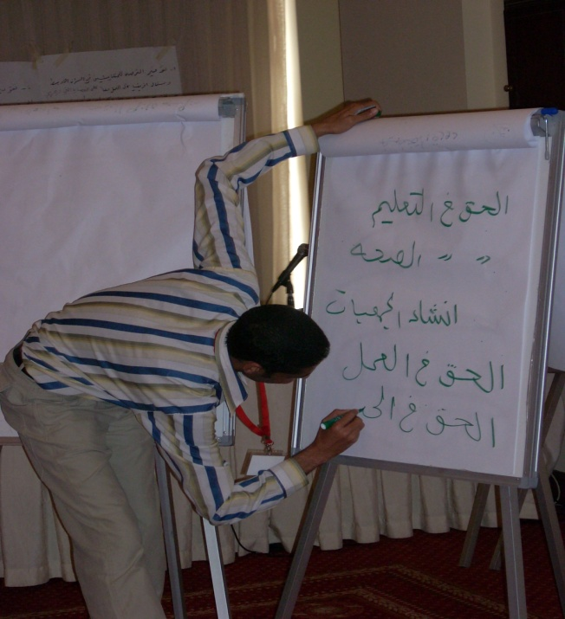
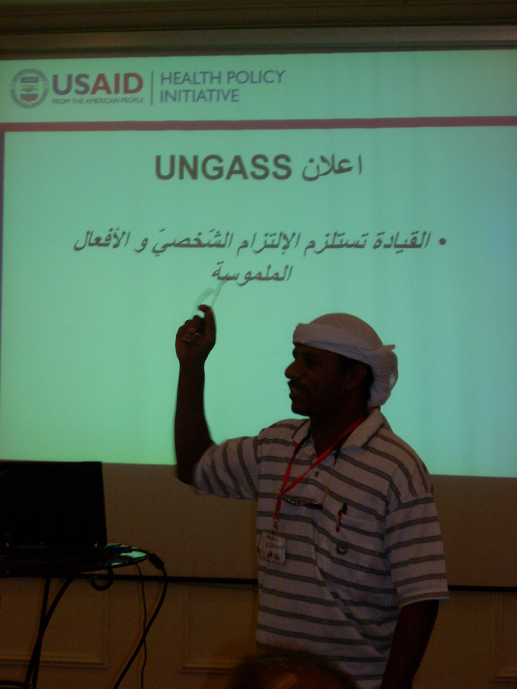
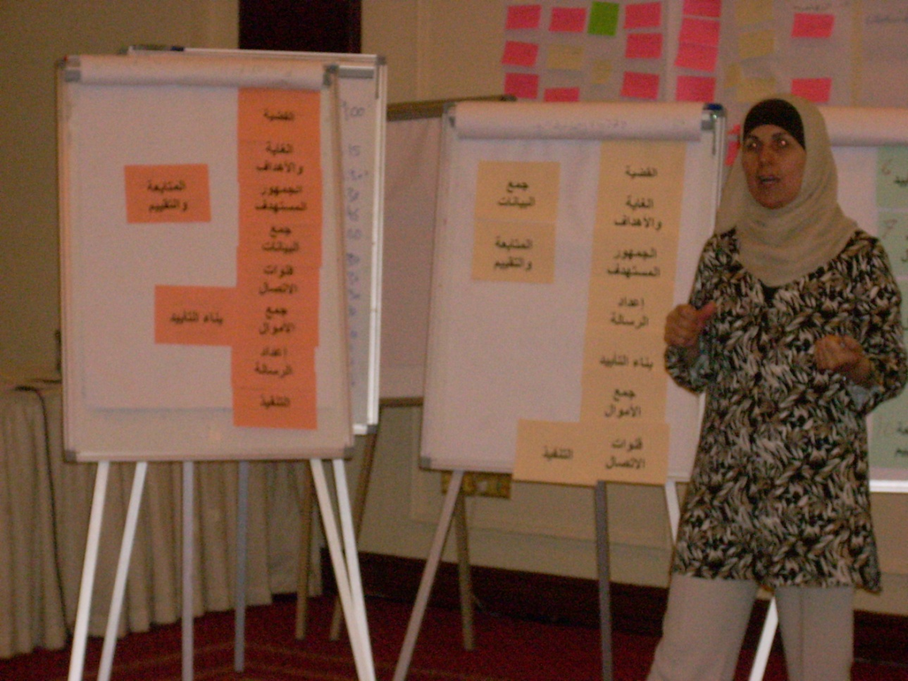

Slide 11
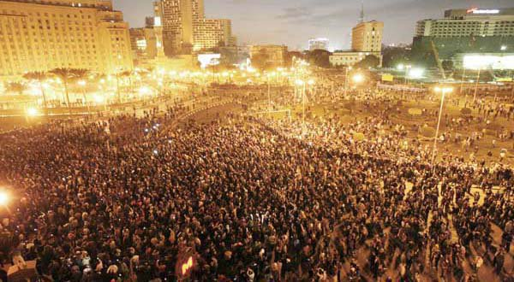

Slide 12
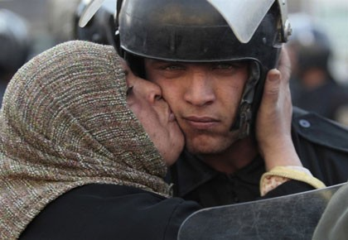
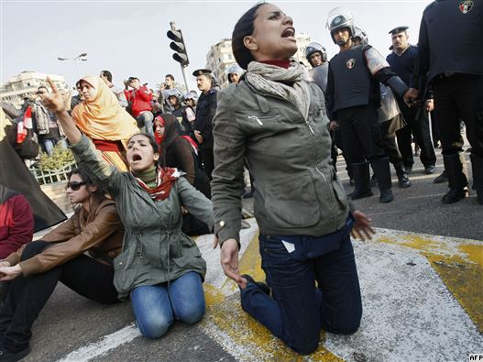



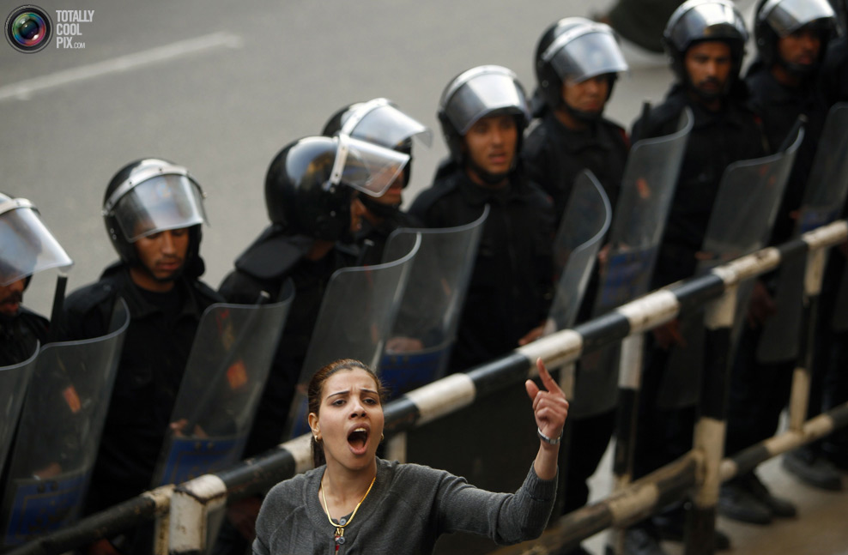
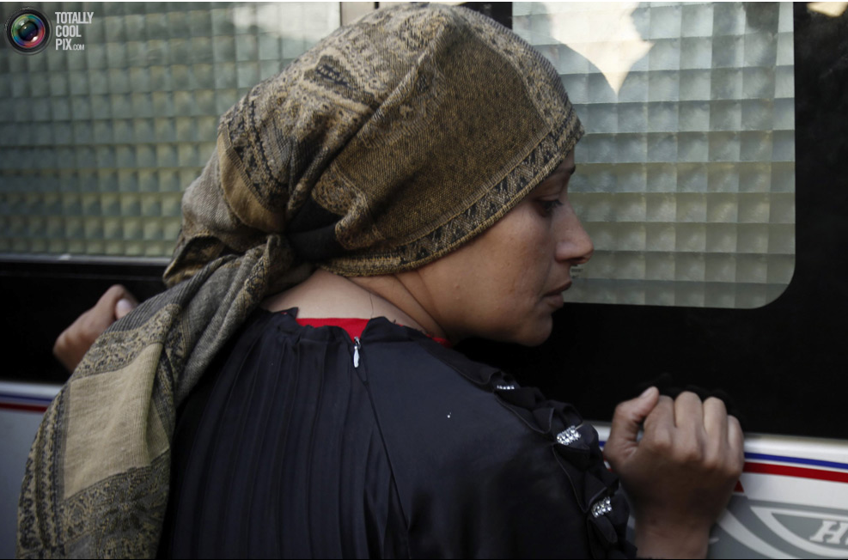

Slide 13
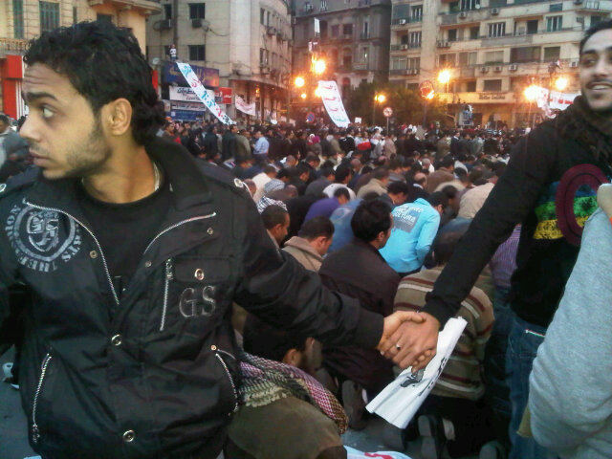

Slide 14
