Slide 1
Preparing for your role
PDG Surgeon Liu
2013-2014 GETS Training Leader
2013-2014 IA Training Leader

Slide 2


1.扶輪 領導發展訓練週期

Slide 3
學習目標
瞭解領導發展訓練週期.
認識你的地區內各種訓練會議.
瞭解你作為訓練領導人的角色.

Slide 4
領導發展訓練週期
Notes:
Series of Rotary-recommended 訓練 會議s
Ensures that club and 地區 領導人s share a common vision

Slide 5
地區各項訓練會議
會議 | 召集人
地區團隊訓練會 | 總監當選人
社長當選人訓練會(PETS) | 總監當選人
地區講習會 | 總監當選人
地區社員講習會 | 總監當選人
地區領導人講習會 | 總監
地區扶輪基金會講習會 | 總監
領導發展計畫 | 總監
扶輪青年服務團領導人訓練會 | 總監

Slide 6
Adult Learning(成人學習)
Rate of attention
We tend to remember after 2 weeks……
10% | of what we read
20% | of what we hear
30% | of what we see
50% | of what we hear & see
70% | of what we say
90% | of what we say & do

Slide 7

I. Your Role- Facilitator
Introduce and present the
topic for discussion
(介紹主題)
Facilitate the exchange of
knowledge and experience
(引導知識及經驗之交換)
Keep the discussion focused
on the learning objectives
(依學習目標來討論)

Slide 8

Facilitation Skills Required-1
(必要技巧)
Listening(傾聽)
Questioning(提問)
Sharing(分享)
Problem solving(解決問題)
Resolving conflict(解決衝突)

Slide 9

Facilitation Skills Required-2
Using a participative style(鼓勵參與)
Accepting others(接受他人)
Empathizing(同理心)
Leading(引導)
Time management(時間管理)

Slide 10

II. Characteristics of Adult Learners
Learning involves(成人學習的特性):
Taking in information(吸收資訊)
Processing information(資訊處理)
Gaining understanding (獲得了解)
Gaining insight(獲得洞見)
Applying what has been learned
(應用所學內容)

Slide 11

Adult Learners-1
Adult learners are usually self-directed.
(自動自發)
The trainer functions as a facilitator
rather than an academic instructor.
(是引言人而非講師)
Learners have individual needs
and learning styles.
(有個別的需求和學習方式)

Slide 12

Adult Learners-2
Learners’ past experiences are useful
in the learning process.
(過去的經驗在學習過程中可發揮作用)
Learning activities should have some
relevance to the learners’ circumstances.
(學習活動需與學習環境有關連)
The environment must be
conducive to learning.
(環境必須有助於學習)

Slide 13

III. Successful Training Tips-1
(成功的訓練技巧)
Speak slowly and clearly(說話緩慢且清晰)
Use visual aids(使用視覺輔助)
Do not use colloquialisms(不要用俚俗語)
Avoid sentences or questions
with negatives(避免負面的敘述和問句)
Re-phrase(改變措詞用字)

Slide 14

III. Successful Training Tips-2
Provide specific examples(提供具體例子)
Avoid interrupting(避免打斷)
Don’t respond immediately(不要立刻回答)
Avoid jokes(避免說笑)
Gender sensitivity (性別敏感度)

Slide 15
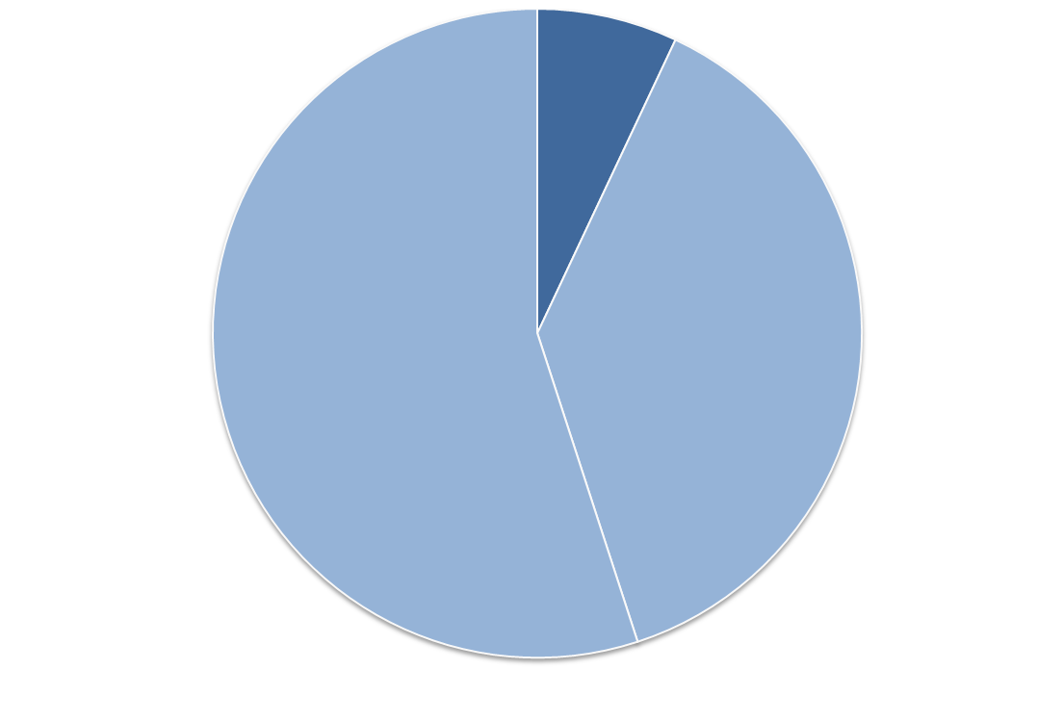
IV. Nonverbal Communication
(非語言溝通)
-Perceived Attitude conveyed-
7%
Verbally(語言)
55%
facial cues
(臉部暗示)
38%
vocal cues
(語言情緒)
Nonverbally (非語言)93%
By Dr. Albert Mehrabian

Slide 16

Nonverbal Languages(非語言溝通)
Body movement and use of space(身體動作和空間使用)
Voice qualities and characteristics(聲音品質和特性)
Eye contact(眼神接觸)
Gestures(手勢)
Silence(沈默)
Facial Expression(臉部表情)
Time/Pace(時間/速度)

Slide 17
V. Effective Questioning Techniques-1
(有效的提問技巧)
Asking participants questions can help to:
Encourage analysis(鼓勵分析)
Broaden participation(擴大參與)
Encourage sharing(鼓勵分享)
Call attention to points that have not been considered(導入尚未討論主題)

Slide 18
V. Effective Questioning Techniques-2
Asking participants questions can help to:
Use conflict constructively(有建設性地利用分歧)
Test the strength of a decision(測試決議的強度)
Close the discussion(結束討論)
Call attention to
the source of information(注意資訊的來源)

Slide 19

VI. Your Session
• Start on time do not wait for late participants(準時上課)
• Introduce yourself briefly (簡介自己)
• End on time the participants need
every minute of their breaks(準時下課)
• You may leave the room as soon as you have completed(下課後即可離開)

Slide 20

Facilitation
Check the environment(上課環境)
Greet participants(歡迎參與者)
Introduce learning objective(介紹學習的目標)
Review learning objectives at the end(複習學習的目標)

Slide 21


Thank you
21

