Slide 1
The Children of Rotary 扶輪之子認養計劃 RI District 3510 國際扶輪3510地區
Reported by: Rotary Club of Harvest, Jenny Chen
報告人：高雄啓禾扶輪社 陳正芬
Notes:
在上任前一年，我們的總監，注意到社會上許多弱勢家庭，大都是隔代教養及單親家庭的小孩，由於政府的法令無法照顧到全部的弱勢家庭，所以，針對這些政府無法照顧到的小孩，由我們來盡一份心力去照顧，這些孩子我們稱他們為扶輪之子。
A year before Jeffrey taking his post as District Governor for 2011~12, our DG Jeffrey noticed that there are many indigent families in our society. Most of these families' children are raised by either single parent or grandparent(s). Since current legislation is not able to take care of all these indigent families, we want to show our effort and concentrate to these children who our government is not able to reach, and named these children as the Children of Rotary.

Slide 2
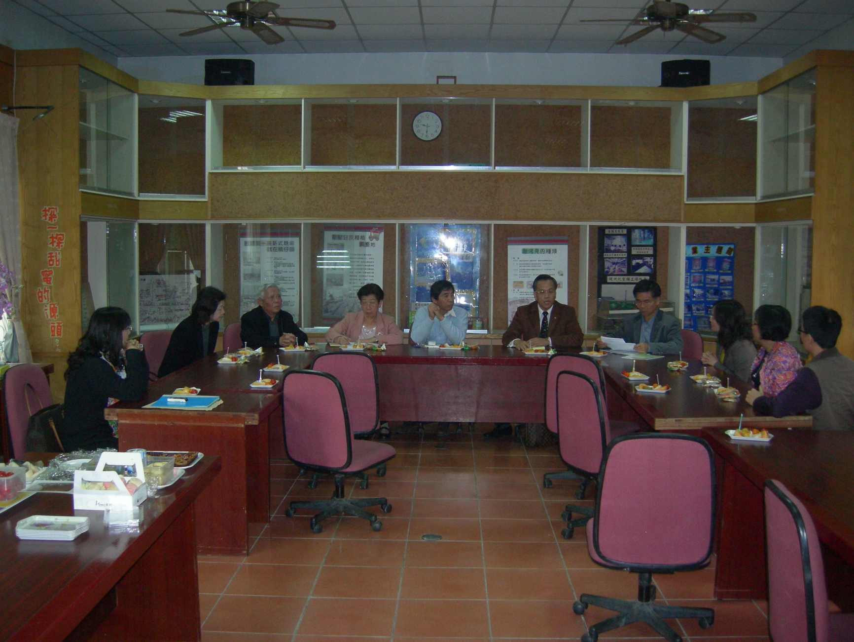
The Children of Rotary Committee visited the chair of Social Affairs Bureau Kaohsiung City Government. 拜訪高雄市社會局局長

Slide 3
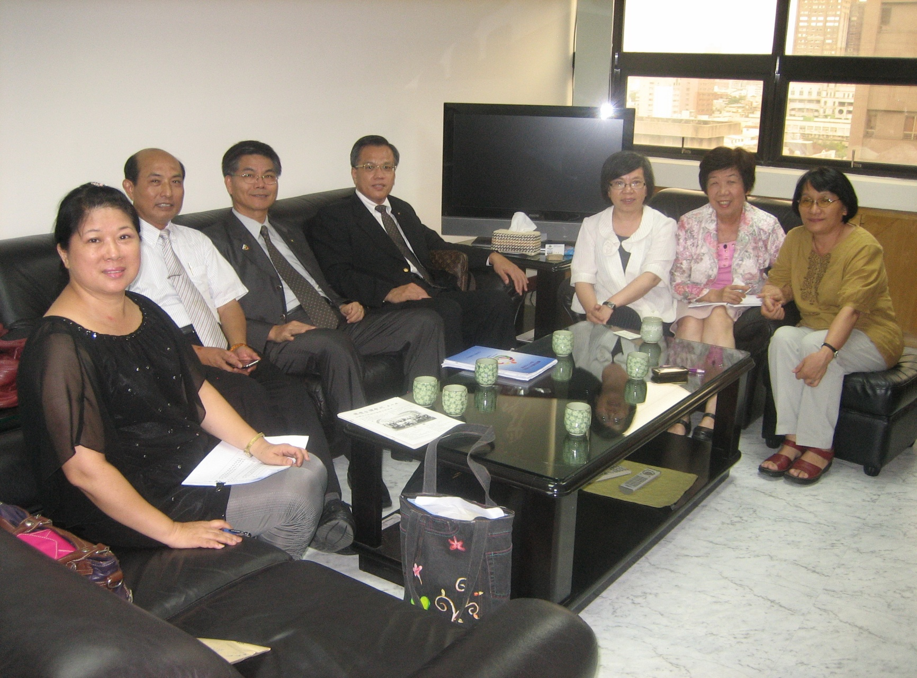
The Children of Rotary Committee visited the chair of Social Affairs Bureau Kaohsiung City Government. 拜訪高雄市社會局局長
Notes:
扶輪之子委員會親自拜訪各轉介機關或學校,尋找扶輪之子。
The Children of Rotary Committee visited several inter-medium agents and schools to look for Children of Rotary.

Slide 4
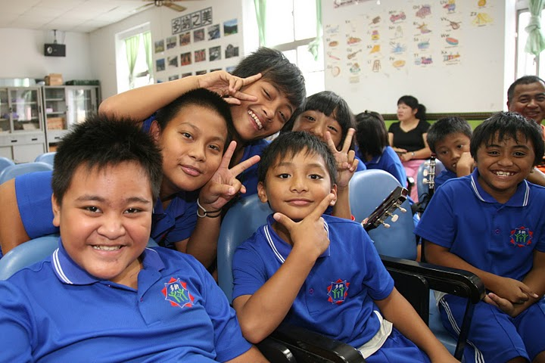
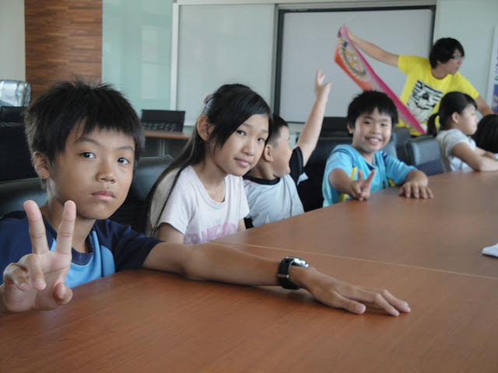
共153名學生給社友自由認養 這些孩子將收到社友贊助獎學金NT$12,000。 153 students were freely chosen to be The Children of Rotary, and each of them had received NT$12,000 in supporting their tuition fee.
社友贊助獎學金NT$12,000
Notes:
從2010年10月到2011年4月，扶輪之子委員會在經過半年的一一訪視拜訪後,開放一百名學生及7個學校專案,共153名學生給社友自由認養, 這些孩子將收到扶輪社友贊助獎學金NT$12,000。由於社友認養踴躍; 總監辦事處再開放登記,於截止日8月15日前登記人數已達229人(總共有158個學生及9個學校專案)。
From Oct., 2010~Apr., 2011, Committee found 100 children and another 53 students who were recommended by seven participated schools (those students were proved to be well performed; however financially in need student). Together, a total of 153 students were freely chosen to be The Children of Rotary, and each of them had received NT$12,000 in supporting their tuition fee. Due to a sufficient amount of members supported this project, Rotary international 3510 district office had to find more children and reopen for more registration. Up to August 15th, registrations had reached 299, including 158 students and nine participated schools.

Slide 5
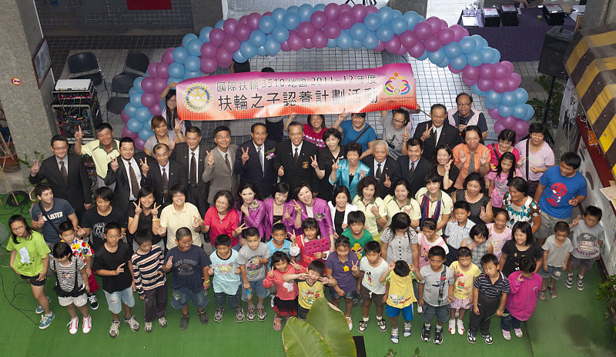
3510地區總監辦事處於10月底前 共舉辦了13場捐贈儀式 RI 3510 district had held 13 dedication ceremonies by end of October.
Notes:
3510地區總監辦事處於10月底前共舉辦了13場捐贈儀式, DG Jeffrey帶著社友與扶輪之子親切互動。
RI 3510 district had held 13 dedication ceremonies by end of October. DG Jeffery and fellow Rotarian had meet and interact with The Children of Rotary.

Slide 6
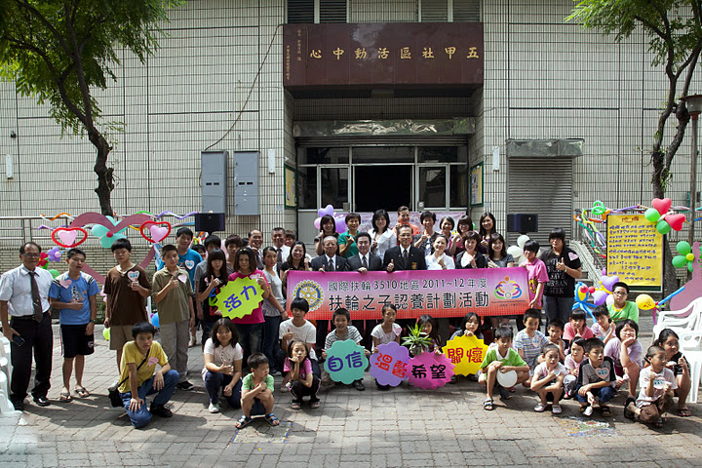

Slide 7
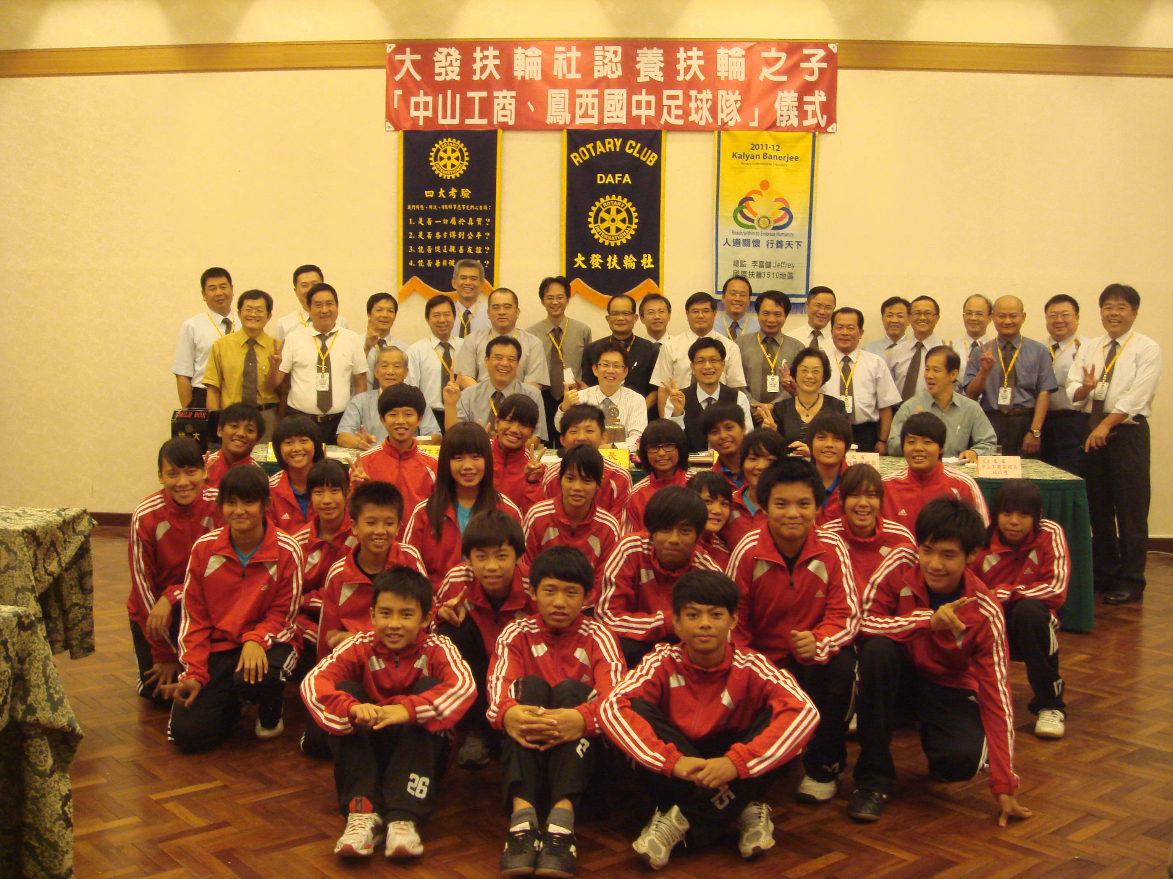
社友們的愛心及總監的指導 總計503位扶輪之子
Notes:
除了扶輪之子委員會提供的229名選定扶輪之子外,各社自行尋找的扶輪之子人數也達274人。配合了國際扶輪六大焦點領域的基礎教育和識字計劃，社友們的愛心及總監的指導，總計503位扶輪之子，在今年，可以開開心心上學去。
Besides 229 children selected by the Children of Rotary Committee, additional 274 children were also reported to be supported by Rotarian own as will. For meeting RI’s Area of Focus, with our Rotarian’s love and DG Jeffrey’s guidance, 503 children of Rotary can happily go to school.
.

